Slide 1
Contents
0. Kick-of sessions
  - Applying through real cases what was learnt in 4 trimesters
  - Identifying which additional tools we need to tackle them
I. Individual behavior (opening the “black box” on individuals)
  1. Role of rationality
  2. Managing incentives
II. Organization (the “inside” of firms)
  3. Markets & organizations. Divisionalization
  4. Markets & politics
III. Institutions (the “outside” of firms)
  5. Institutional support of private contracting
  6. The role of firms in society, CSR

Slide 2
Contents
0. Kick-of sessions
  - Applying through real cases what was learnt in 4 trimesters
  - Identifying which additional tools we need to tackle them
I. Individual behavior (opening the “black box” on individuals)
  1. Role of rationality
  2. Managing incentives
II. Organization (the “inside” of firms)
  4. Markets & organizations. Divisionalization
  3. Markets & politics
III. Institutions (the “outside” of firms)
  5. Institutional support of private contracting
  6. The role of firms in society, CSR

Slide 3
Managing incentives
Notes:
exercise in Econ Anal of Canon Law

Slide 4
Outline: managing incentives is...
Hard, even assuming homo economicus, eg:
  Agency & multitasking: e.g., quality vs. quantity
    Introduced in Business Economics: remember Kerr’s “Getting B When You Aimed for A”
Need to consider human nature (e.g., emotions) → Readings in this topic:
  Fehr & Falk’s survey of experiments
  Cowen’s soft essay

Slide 5
Fehr & Falk 2002
“Psychological Foundations of Incentives”

Slide 6
Summary
Economics based on a naive view of incentives: centered on effort and risk aversion
Need to consider “preferences” for:
  Reciprocation
    “Strong” reciprocity, unrelated to expectation of future gains, as in direct or indirect (reputation-based) reciprocity
  Social approval
  Interesting work (will not be covered here)

Slide 7
I. Perspectives on reciprocity.
Four experiments:
Source of voluntary cooperation
  Voluntary = not based on expectation of gains → not cooperative or retaliatory (e.g., “tit for tat” strategy)
Explicit incentives vs. voluntary cooperation
Reciprocity as support for “relational” incentives
Incentives based on reciprocity and repetition

Slide 8
1. Reciprocity as a source of voluntary cooperation
Anonymous strangers & without repetition
“Gift exchange” experiment:
  Employer offers wage w (w = 0, 1, …, 100) for a “desired” effort ê, which is not binding → earns 100 e - w
  Employee freely chooses real e within (0.1, 0.2, ... , 1) →
  at a cost c(e), between 0 & 18, increasing and convex → earns rent w - c(e)
What’s the “rational” solution for homo economicus?
  Anticipating minimum effort, employer should offer minimum wage
  But, in fact, employers appeal to workers’ reciprocity →

Slide 9
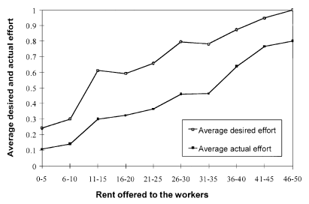
Fig. 1. Rent offered to workers and avg. desired & actual efforts (Fehr et al., 1997)
Desired effort
Real exerted effort
= wage – cost of effort

Slide 10
Analysis
Remember: anonymity → Reciprocity not caused by expectations of future gains
Employers: Greater effort desired, ê →
→ greater wage offered, w →
→ greater rent w - c(e)
    Important check: employers offer less if e exogenous → they’re looking for reciprocity, not for “sharing” gains
Employees: Greater rent offered →
→ greater real effort, e
  On average, they respond reciprocally
But:
  Below “desired” level
  40-60% of choose minimum effort
Desired effort
Real exerted effort
= wage – cost of effort

Slide 11
Applications of reciprocity-driven voluntary cooperation
If employees have discretion, motivation cannot be based only on incentives
Importance of
  Selection: (firing) & recruiting (un)cooperative types
    remember that 40-60% chose minimum effort
  Careful management of beliefs to induce cooperation
    Reciprocity could explain downward wage “rigidity”

Slide 12
2. Explicit incentives and voluntary cooperation
Experiment with employers that contract using three alternative treatments:
  As before (“no incentive”)
  With “wage deduction” (fine) charged with probability 1/3 to shirkers (“negatively framed”)
    with self-interested workers, better (max)fine
  With “bonus payment” (“positively framed”), also paid with probability 1/3, thus producing the same compensation function as a fine

Slide 13
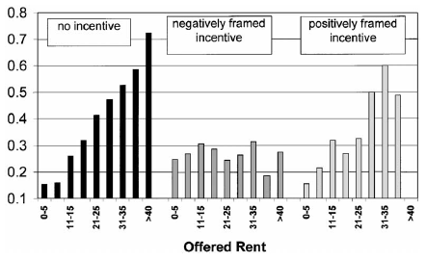
Fig. 2. The impact of explicit incentives on actual average effort (Fehr and Gächter, 2000b).

Slide 14
Analysis
When they could set fines
  Most (98.5%) did and chose the maximum (69%)
  Voluntary cooperation disappears (“crowding out”)
    Even when high rent offered
    Causes lower surplus, lower wages & higher employers’ profits
  Why does voluntary cooperation disappear?
    Introducing a fine is seen as and/or reveals distrust: contradiction between fine and generosity
    Logic from Evolutionary Psychology: type identification (?)
Mathematically identical “bonuses”
  A bit worst than w/o incentives but
  small sign. effect →
  “Framing” essential in incentives

Slide 15
Abstaining from stipulating fines
Trust game, one-shot
  Endow A and B with 10€
  A give x€ to B, says that expected to receive y^{e} back, and can stipulate a fine <4€ if B transfers back y < y^{e}
  B distributes 3x, giving y to A
Results
  “Rational”: x = y = 0; x = 1 ó 2
  Real¨: ...

Slide 16
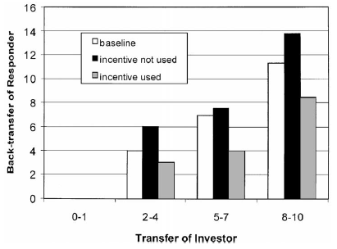
Fig. 3. Responders’ back-transfers as a function of the investors’ transfers
(Fehr and Rockenbach, 2001)

Slide 17
Analysis
Results
  Common
    Positive initial transfers
    Back transfers increase with initial transfers
    Greater effects for managers than students
  Important: Back transfers smaller (greater) when stipulating (not stipulating) an available fine
    Average (y/3x) = 30.3%; 47.6%; 40.6%
Explicit incentive perceived as hostile triggers perverse effects: eliminates voluntary cooperation
Application: marriage contracts

Slide 18
3. Reciprocity as support for “relational” incentives
Same experiment (“gift exchange”, anonymous, no repetition)
but
  employer observes real effort and
  Can reward (punish) higher (lower) effort,
    spending up to 10€ so that each ±1€ spent in reward / punishment generates ±2.5€ for the employee

Slide 19
Results
Although it is “irrational” to reward or punish, most do:
  If e < ê 68% punish, with 7€ on average
  If e > ê 70% reward, with 7€ on average
  If e = ê 41% reward, with 4,5€ on average
Employees
  anticipate reciprocity (54-98%)
  raise effort (from 0,37 to 0,65 on average); and
  adjust real to requested effort
Net surplus increases 40%, despite expenditure in punishment
Application:
  Contracting without verifiability by 3rd parties (judges) → “implicit” contracting with “2nd party relational enforcement”
    Viable with mandatory 3rd party enforcement?

Slide 20
Reciprocity and explicit contracts
Experiment
  10 one-shot rounds
  Two tasks, with efforts e₁ y e₂ (both between 1 and 10), observable, but e₂ nonverifiable by third parties
  Efforts are complementary: Principal’s revenue = 10 e₁ e₂
  Cost of effort increases with (e₁+e₂), and convex
  Principal chooses a contract for each period:
    Piece rate: fixed + variable con e₁ + “desired” ê₁ y ê₂
    Bonus: fixed + “desired” ê₁ y ê₂ + bonus after observing e₁ & e₂
“Rational” response: given that efforts and bonus are mere promises, principals will offer piece rate and agents will minimize e₂ . But ...

Slide 21
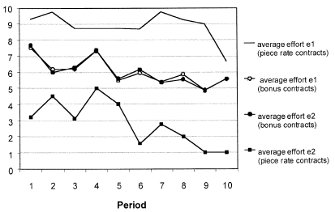
Fig. 4. Average effort in piece rate and bonus contracts (source: Fehr et al., 2001)

Slide 22
Analysis of results
Piece rate
  Efforts very unequal
  e₂ converges to the minimum
Bonus (chosen by 81% of cases)
  Reciprocal employers offer bonuses increasing with total effort and decreasing with difference between efforts
  Reciprocal employees equalize efforts
Applications:
  Avoid partial measurement of performance
  What is the consequence that parties have unforfeitable “right” to “appeal” to courts?

Slide 23
4. Incentives based on reciprocity and repetition
Experiment as in the first experiment (“gift exchange”), comparing:
one-shot
repeated interaction
  Repeated 15 times with traders identified with an ID number
  Offers include wage, w; desired effort, ê, employer ID) and can be
    Private to as specific worker → long term relationship
    Public to all workers
  7 employers, 10 workers → “firing” is a punishment
  Will the availability of firing crowd out cooperation?

Slide 24
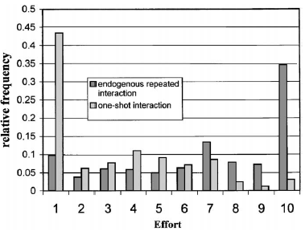
Fig. 5. Distribution of effort in one-shot and endogenously repeated gift exchange games (source: Brown et al., 2001)

Slide 25
Analysis of results
One shot
  Mode at minimum effort (43% of selfish workers)
  Majority of efforts at greater than minimum
Repeated
  Mode at maximum effort (35% of selfish workers)
  Majority of efforts lower than maximum
Applications:
  Conventional reciprocity has a substantial effect
  Firing did not crowd out voluntary cooperation → Punishments should be implemented implicitly, without “offending” cooperators nor signaling to be a bad type

Slide 26
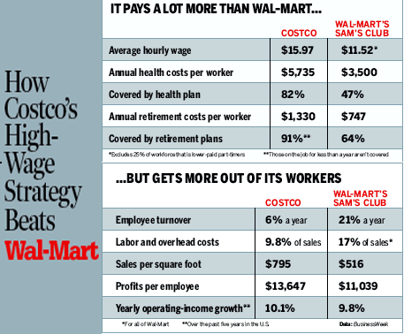
How do you explain these differences?
Please, use insights from this topic, but also two basic some concepts studied in Business Economics. You may see a description and discussion in this paper. er ‘04
Notes:
What about moral hazard and selection?

Slide 27
II. Social approval
Social approval and disapproval modify conduct, not only because they generate future benefits but because they trigger emotions
Experiment
  Each one of 10 strangers contributes x€ to a common pool, the pool is doubled and divided equally among the 10 → the individual contributing 1€ loses 0.2€
  Two cases, depending on contributions being:
    Anonymous → they contribute 34% of endowment
    Public → idem 68%

Slide 28
Reciprocity in public goods
Individuals contribute money to a common pool, expecting an equal share in a multiple of the pool
  People start contributing more but their contributions decay with time and approach zero at the end
  When contributors can punish free-riders even at a cost (“strong reciprocity”), they do it, motivating cooperation
Depending on punishing circumstances,
  free riders lead incapable-to-retaliate contributors to free ride
  contributors willing to costly retaliate lead fee riders to contribute
But also “antisocial punishment”: cheaters punish cooperators
  Key: the role of culture, in both firms and societies (next slides)
  Managerial applications
    Manage expectations
    Select loyals
    Dismiss free riders

Slide 29
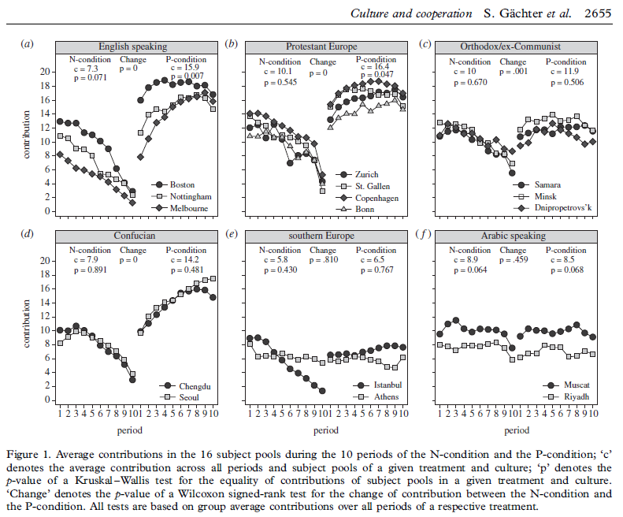
Social and antisocial punishment in different cultures
Two public-good experiments with and without costly punishment
  N-condition P-condition
  Without With
  (left) (right)

Slide 30
Social and antisocial punishment in different cultures

Slide 31
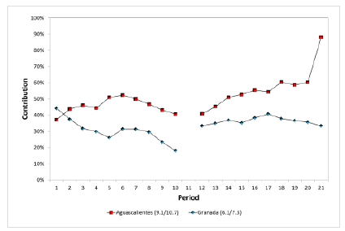
Spain, intermediate results: like Italy, better than Greece, worst than, e.g., SWZ (prelim., Arechar 2013)

Slide 32
Kinship traits that characterize WEIRD societies
% of 1,200 pre-
industrial societies
bilateral descent (relatedness
traced through both parents) 28%
little or no cousin marriage 15%
monogamous marriage only 25%
nuclear family households 8%
neolocal residence (new couples
set up a separate household) 5%

Slide 33
WEIRD hypothesis on 1st round contributions, no punishment
WEIRD = Western, Educated, Industrialized, Rich, and Democratic
Source: Henrich, J., The WEIRDest People in the World, 2020

Slide 34
The WEIRD hypothesis with punishment
WEIRD = Western, Educated, Industrialized, Rich, and Democratic
Source: Henrich, J., The WEIRDest People in the World, 2020

Slide 35
Possible explanation based on how societies sustain social norms through punishment
(Henrich 2020: 221-ff)
Kin-based societies
  Norm-violators are punished by relatives or traditional authorities to preserve the clan’s collective reputation
  Strangers not allowed to punish
  In the experiment: low contributors end up retaliating against high contributors presumed to have been punishing them
Societies with weak kinship
  Strangers can punish, no retaliation, ‘good’ equilibrium
But cross-cultural diffs. hotly debated:
  e.g., skim metanalyses: Thöny’18 & Spadaro et al.’22

Slide 36
II. Social approval
Social approval and disapproval modifies conduct, not only because it generates future benefits but because it triggers emotions
Experiment
  Each one of 10 strangers contributes x€ to a common pool, the pool is doubled and divided equally among the 10 → the individual contributing 1€ loses 0.2€
  Two cases, depending on contributions being:
    Anonymous → they contribute 34% of endowment
    Public → idem 68%
Social approval incentives increase with average contribution → Multiple equilibriums (Fig. 6)

Slide 37
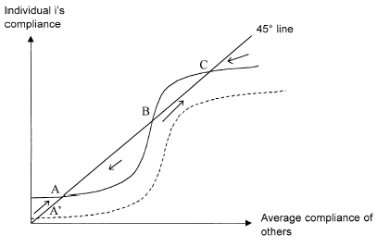
Fig. 6. Multiple equilibriums in the presence of social approval
Shock C → A caused by an exogenous shock to the reaction function
Unstable equilibrium B
Stable and good equilibrium, C
Stable but bad equilibrium, A

Slide 38
Fig. 6. Multiple equilibriums in the presence of social approval
Shock C → A caused by an exogenous shock to the reaction function
How do we jump from bad equilibrium A to good eq. C?

Slide 39
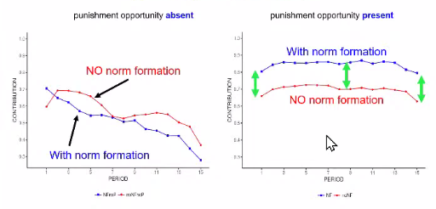
Punishment more important than norm formation
Norms show little effect without punishment
The effect of punishment is greater with norms
Source: Fehr & Schurtenberger, 2020

Slide 40
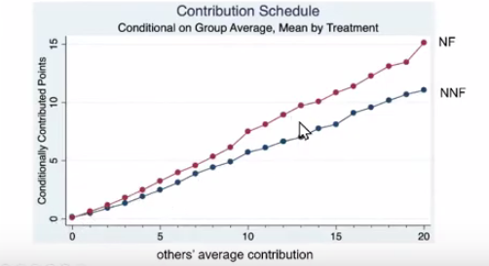
Norm formation opportunity seems to sustain cooperation beliefs and so contain unravelling, but needs some mechanism to ensure conditional cooperation
(built, in the graph, as a function average previous contributions)
Red: norm formation opportunity
Blue: no norm formation opportunity
Source: Fehr & Schurtenberger, 2020

Slide 41
Incentives and social norms
Ex.: pricing delay in a kindergarten
(Gneezy & Rustichini, 2000a)
Problem: parents picked up their children late, violating a rule
New policy announced: delays longer than 10 minutes over the “official closing time” will be fined, with the fine added to the monthly bill
¿What consequences should be expected...
  ... from the new fining policy?
  ... from suppressing the policy two months later?

Slide 42
Consequences:
  Without fines
    Few delays (8 per week)
  After the new fining policy ($3) starts at week 4
    Number of delays remains constant in weeks 5 and 6
    Number of delays increases after week 7 (about 20 per week)
  After suppressing the fining policy in week 16
    Delays remained constant at a level double the initial one
Interpretation
  Were fines too low? ($3 per delay in a total monthly fee of $380)
  A morally ambiguous message suppressed the social norm and generated a market transaction?
  In terms of Fig. 6, parents moved from C to A’ and then to A
Examples
  parking fines not collected in some cities?
  your experience with norms on smoking, exam cheating, etc.?

Slide 43
Social norms & formal rules
“Cultural explanations are useless. E.g., we Spaniards now drive much more slowly”
  Was there info asymmetry on speeding? Sustainability
  Adapted: “Catholic” measures (ex ante control of all drivers)
Do institutions (formal rules) produce our culture?
  Long run: e.g., the Reformation as institutional change
Social norms constrain successful institutional change
  Is this important for institutional “transplants”?
    Danish labor “flexicurity”? Finish schools?
Notes:
43

Slide 44
Spanish values (norms) as compared to those in main EU countries
Responsibility
  We value less how democracy works, politicians & institutions; but we are also the less informed
  Only country in EU where citizens blame more Northern than Southern Europe for the economic crisis
Social preferences
  With Italy, country with strongest / weakest belief that the State / the individual “should have primary responsibility for ensuring a decent level of life”
  Least support for the market economy
Source: Study on World Values, FBBVA, 2013, 2019

Slide 45
III. Interesting work
Crowding out of “intrinsic” motivation (enjoying work): it is alleged that it disappears when explicit incentives are introduced
  Case: incentives to Spanish judges: “consistent with a potential deterioration of intrinsic motivation, top performing judges significantly reduced their production”
Weak evidence
  Inappropriate situations, in which compensation is usual
  Does separate the “disappointment” effect
  Paying signals work should be paid
It is often confused with
  Reciprocity and
  Social norms
Need to manage effort—also “self-manage” effort?
Notes:
Performance Pay and Judicial Production: Evidence from Spain∗ Manuel Bagues † Berta Esteve-Volart ‡ June 2010 Abstract This paper analyzes the effects of the introduction of a performance pay scheme rewarding Spanish judges. The Spanish top judicial authority established modules of production for every task judges undertake and then calculated production benchmarks. Since 2004, judges were awarded a 5% bonus if production exceeded the benchmark by 20%. We find that the introduction of this scheme increased the number of judges exceeding this threshold, and also increased average production. Nevertheless, we also observe that, consistent with a potential deterioration of intrinsic motivation, top performing judges significantly reduced their production.

Slide 46
Social norms in employment will withhold or enhance effort?
  Under piece rate/sharing/tournament compensation systems?
Identify some work that people are now doing voluntarily
  What the effect of paying them for doing it would be?
  Would it make sense to replace prisons with fines?
  Would it make sense to pay students for attending classes?
How would you apply the analysis of social approval in the article by Fehr & Falk to…
  taxation? Compared to home owner associations?
  and to parental authority?
    Think, for example, that parents are enforcers of rules with respect to their children. But they establish and enforce these rules within a social environment containing formal rules (e.g., inheritance) and informal social norms (e.g., widely accepted standards of behavior).
    Can these norms be seen as an equilibrium resulting from individual parents’ actions? How are they evolving?
    What are parents’ preferences RE social norms? Are these preferences homogenous? E.g., purchase & use of smartphones to children
    How are norms affected by social rules?
    A recent example: the discussion on children homework.

Slide 47
Cases for discussion
Notes:
47

Slide 48
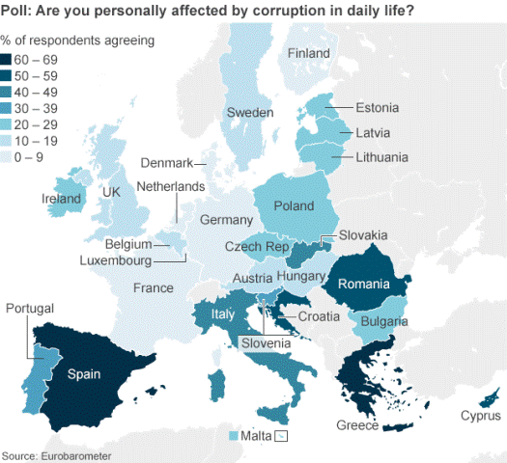
48

Slide 49
What do we think of someone who…
avoids paying taxes?
does not return a wallet containing money?
dodges paying for a ticket on the Metro?
  steals someone else’s Metro season ticket?
slips a friend in for hospital tests?
works while collecting unemployment benefits?
keeps a commission for organizing a graduation party?
keeps some of the money collected for a graduation trip?
often misses classes?
copies in exams? … problem sets?
  copies from you without permission?
hides reserved book in the library stacks?
Notes:
49

Slide 50
How does “the market” affect cooperation?
Empirical evidence from cross-cultural experiments
  Voluntary cooperation (i.e., w.r.t. strangers) increases when subjects have been living in developed societies versus tribal (hunter-gathering) societies
  Example: making and accepting unequal offers in ultimatum game depends on internalized social norms
    Why is voluntary cooperation lower for students and people below about 25 years old?
    Why is cooperation lower the more time subjects have to think?
    See, for a summary, e.g., Henrich (2016) →
Notes:
50

Slide 51
“games often tap social norms that people bring into the laboratory from their social lives outside, and consequently game play varies dramatically across societies. In modern industrialized societies, these experiments often measure social norms that regulate impersonal exchange and other social interactions, and evolved culturally to facilitate mutually beneficial interactions in large-scale societies with lots of strangers and anonymous interactions. The strength of these impersonal norms, though unusual, is a key feature of many modern societies. By contrast, the smallest-scale human societies tend not to offer very much nor reject low offers because they lack social norms for monetary exchanges with strangers or anonymous others” (Henrich 2016:192).

Slide 52
Cowen 2007, Ch. 2
“How to Control the World: The Basics”

Slide 53
Do monetary incentives work?
Poll at Davos World Economic Forum:
  Recognition and respect as number 1st motivator at workplace
  Achievement and accomplishment 2nd
Why didn’t the Soviet Union work?
Would your behavior change if you win the lottery?
Monetary incentives for what types of jobs?

Slide 54
Four rules
Offer monetary rewards when…
  performance highly responsive to effort
    Mechanical, simple work. Cold water experiment
  weak intrinsic motivation (e.g., garbage collection)
    Paying for grades in school… for which students? → next
    Importance of subj. discount rate for managing incentives
  receiving money produces social approval
    E.g., teenager as cashier vs. doing dishes at home
    To discuss: stigma (disapproval) for unemployment benefits
High rewards tend to make individuals “choke”
  Fear to error or excuse?
  Millenials denial of career prospects?

Slide 55
Three parables
Doing the dishes
  Should parents pay children to wash dishes?
Car salesman
  Correspondence between effort and results
  Is this work fun?
UN parking tickets
  UN representatives in NYC parking violations
  Social approval, meritocracy varies across environments
    Social norms → We are “environmentally” cooperative: e.g.,
      Kuwait hospitality vs. Norway’s 25% absenteeism
      Do you speed? Anywhere? Have you ever cheated?
Notes:
Considering readings in topic #1, are some of these parables explained by subjective discount rate (future rewards do not motivate if discount rate is high) and collisions between motivational systems?

Slide 56
The WEIRD hypothesis on UN parking tickets
WEIRD = Western, Educated, Industrialized, Rich, and Democratic
Source: Henrich, J., The WEIRDest People in the World, 2020

Slide 57
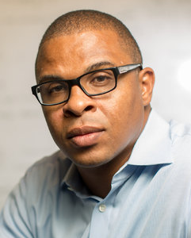
Paying students (and teachers?) for grades, or for inputs?
The pioneer
Better to pay for inputs than for outputs.
See, e.g.,
Prof. Roland Fryer (Harvard)
Allan & Fryer, 2011, “The Power and Pitfalls of Education Incentives”.
“Paying Students to Do Well in School: What Economists Are Learning about Pay-4-Performance”
“Paying Students May Raise Test Scores, But The Lesson Is Not Over” (NPR).

Slide 58
Cases for discussion
Notes:
58

Slide 59
Are incentives “effective”?
What do we mean by “effective”?
Yes, they are, but, unexpected results b/c two main sets of reasons
  Quality versus quantity: Kerr in Business Econ: “Getting B when you aimed for A”
    Rat extermination/farming, preventive fires & healthcare, organ transplants?, army paid by casualties caused, etc.
  Human nature—harder problem
    Effective use of assumptions & empirical knowledge

Slide 60
Does voluntary cooperation exist?
  Examples? http://bit.ly/wt61P6
  Do all individuals cooperate voluntarily?
When voluntary cooperation does exist, how do explicit incentives affect it?
Can “strong” reciprocity...
  ... help us negotiate?
  ... create new types of incentive?
  ... alleviate the problem of collective action (“public goods”)?
Do you interpret “indignation” as “strong reciprocity”?
In Spanish politics? EU politics (e.g., EU-Greece)?
  Or more simple emotions, such as anger, rage, envy?
  Are incensed citizens, “indignados”, incurring a cost?
  Can it channeled productively?
Notes:
60
60

Slide 61
What would happen if we were to fine you for arriving late?
  What’d happen if we lift the fines 2 weeks later?
How will you motivate your children to make their beds?
  BTW, do you make your own bed?
  How would you interpret it in educational terms?
If NYC could fine foreign UN diplomats for parking incorrectly, would they park better? Would they all react the same way?
Notes:
61
61

Slide 62
How should we provide better incentives for university teachers?
How should we provide incentives for university students?
  Consequences of bonuses? Fee discounts better?
And for teachers’ evaluations by students?
  What would happen if teachers were paid according to students’ evaluations?
  What have you learnt from the Bocconi study?
Notes:
62
62

Slide 63
How have “your brothers & sisters” being trained to face their professional career?
Some illustrations and examples

Slide 64
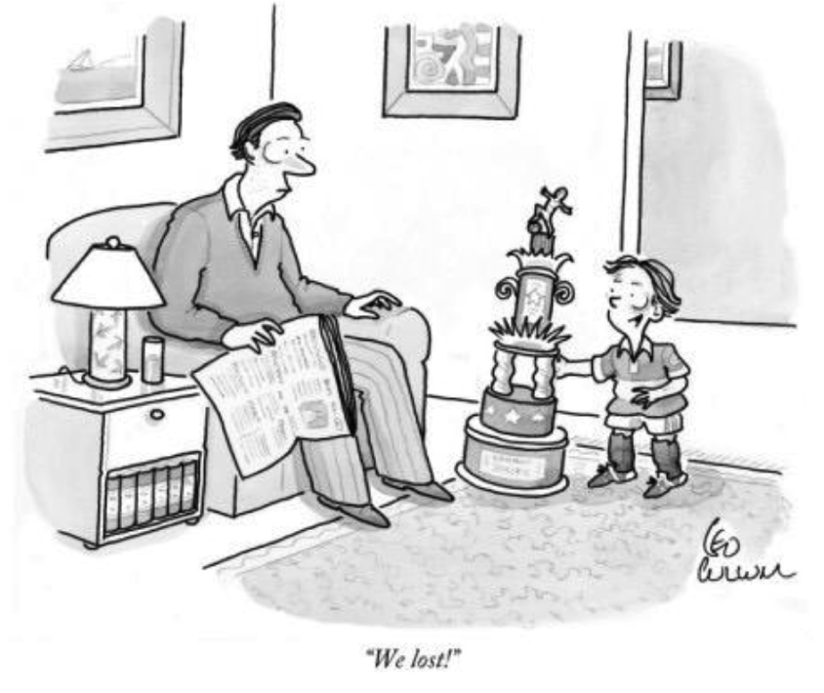

Slide 65
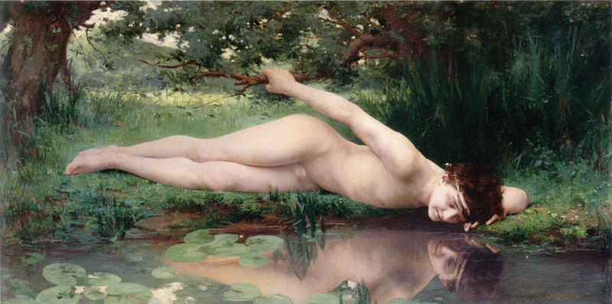
Is it justified the recurrent criticism of “millennials” as narcissists?
Millennial: “a person reaching young adulthood in the early 21st century”
Narcissist: a person with “excessive interest in or admiration of oneself”

Slide 66
A couple of examples
2007 CTBP project definition: “How graduates must adapt their ‘emotional intelligence’ to succeed in their first jobs”
  Students’ counter proposal: “How employers must modify the jobs they offer to suit the new demands of young graduates”
2017 discussion question: “Build a list of biases that graduates have to manage to develop a successful professional career”
  Bias found: “Age Bias: older managers see young graduates as unqualified because they are young”

Slide 67
Guzmán de Alfarache
“It was difficult for me to learn to serve when I had been taught to give orders”?
  (“Se me hacía duro aprender a servir habiendo sido enseñado a mandar”)

Slide 68
Excessive risk aversion?
E.g., students’ fear being unable to answer sharp EO&M/EI&M exam questions
They’d be happy w. responding “it depends”
Final exam is not risky because
  It counts for 50% of the total grade
  It contains at least 30 questions; therefore, there is plenty of diversification
  Some degree of ambiguity is inevitable, but it’s
    Much less than in real life: therefore,… get accustomed
    It’s the same for all students. Thus, mostly irrelevant for individual grades

