Slide 1
Blockchain & “Smart Contracts”: Is it viable an economy without intermediaries?
Benito ARRUÑADA Pompeu Fabra Univ.
2018

Slide 2
Based on
Arruñada, B. (2018), “Blockchain’s Struggle to Deliver Impersonal Exchange,” Minn. J. of Law, Science & Technology.
Arruñada, B., & L. Garicano (2018), “Blockchain: The Birth of Decentralized Governance,” Work in Progress.

Slide 3
Outline
Introduction
Bitcoin, blockchain, smart contracts
Promise & reality
Scalability (FB = 25,000 x ETH)
Usability, from a law & econ view
Contract completion
Enforcement, personal
Enforcement, real
Organization of platforms
Conclusions

Slide 4
Emphasis
Introduction
Bitcoin, blockchain, smart contracts
Promise & difficulties
Scalability
Usability, from a law & econ view
Contract completion
Enforcement, personal
Enforcement, real
Organization of platforms
Conclusions

Slide 5
Introduction to blockchain
Technology behind Bitcoin
It replaces centralized intermediaries, enabling P2P markets by verifying & keeping a record of transactions
Decentralized, ≈ peer-to-peer consensus
Secured by competitive “mining” + cryptographic hashing & concatenation + network-wide replication
Mining: think of guessing a really long number
See 15 min. video: https://www.youtube.com/watch?v=93E_GzvpMA0
Evolution: Bitcoin → DApp = Set of “smart contracts”:
Automatic contract verification & execution → “Code is law”
Without trusted third parties; therefore, disruptive…?

Slide 6
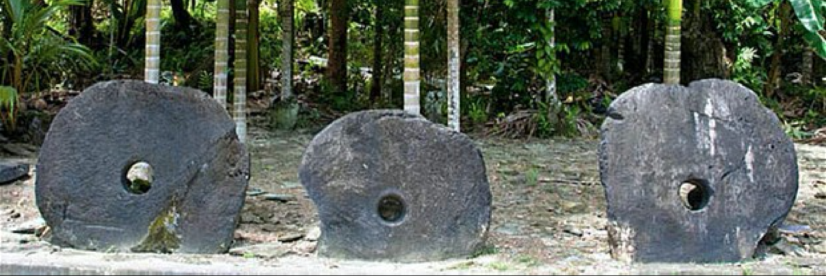

Slide 7
Rai, or stone money. . . . have been used in trade by the Yapese as a form of currency. The monetary system of Yap relies on an oral history of ownership. Because these stones are too large to move, buying an item with one simply involves agreeing that the ownership has changed. As long as the transaction is recorded in the oral history, it will now be owned by the person it is passed on to and no physical movement of the stone is required. . . . In one instance, a large rai being transported by canoe and outrigger was accidentally dropped and sank to the sea floor. Although it was never seen again, everyone agreed that the rai must still be there, so it continued to be transacted as genuine currency.

Slide 8
Blockchain promise
Huge
Automatic contract completion & enforcement (“code is law”) & “transfer any kind of asset”
Without central agents for neither
Completion → │ “trust specialists” are
Enforcement → │ made obsolete
Huge investments
Only in finance, $1B in 2016
In all, $3B in 10 first months of 2017
Projects in all industries & sectors, public & private
Decentralized with very low fees

Slide 9
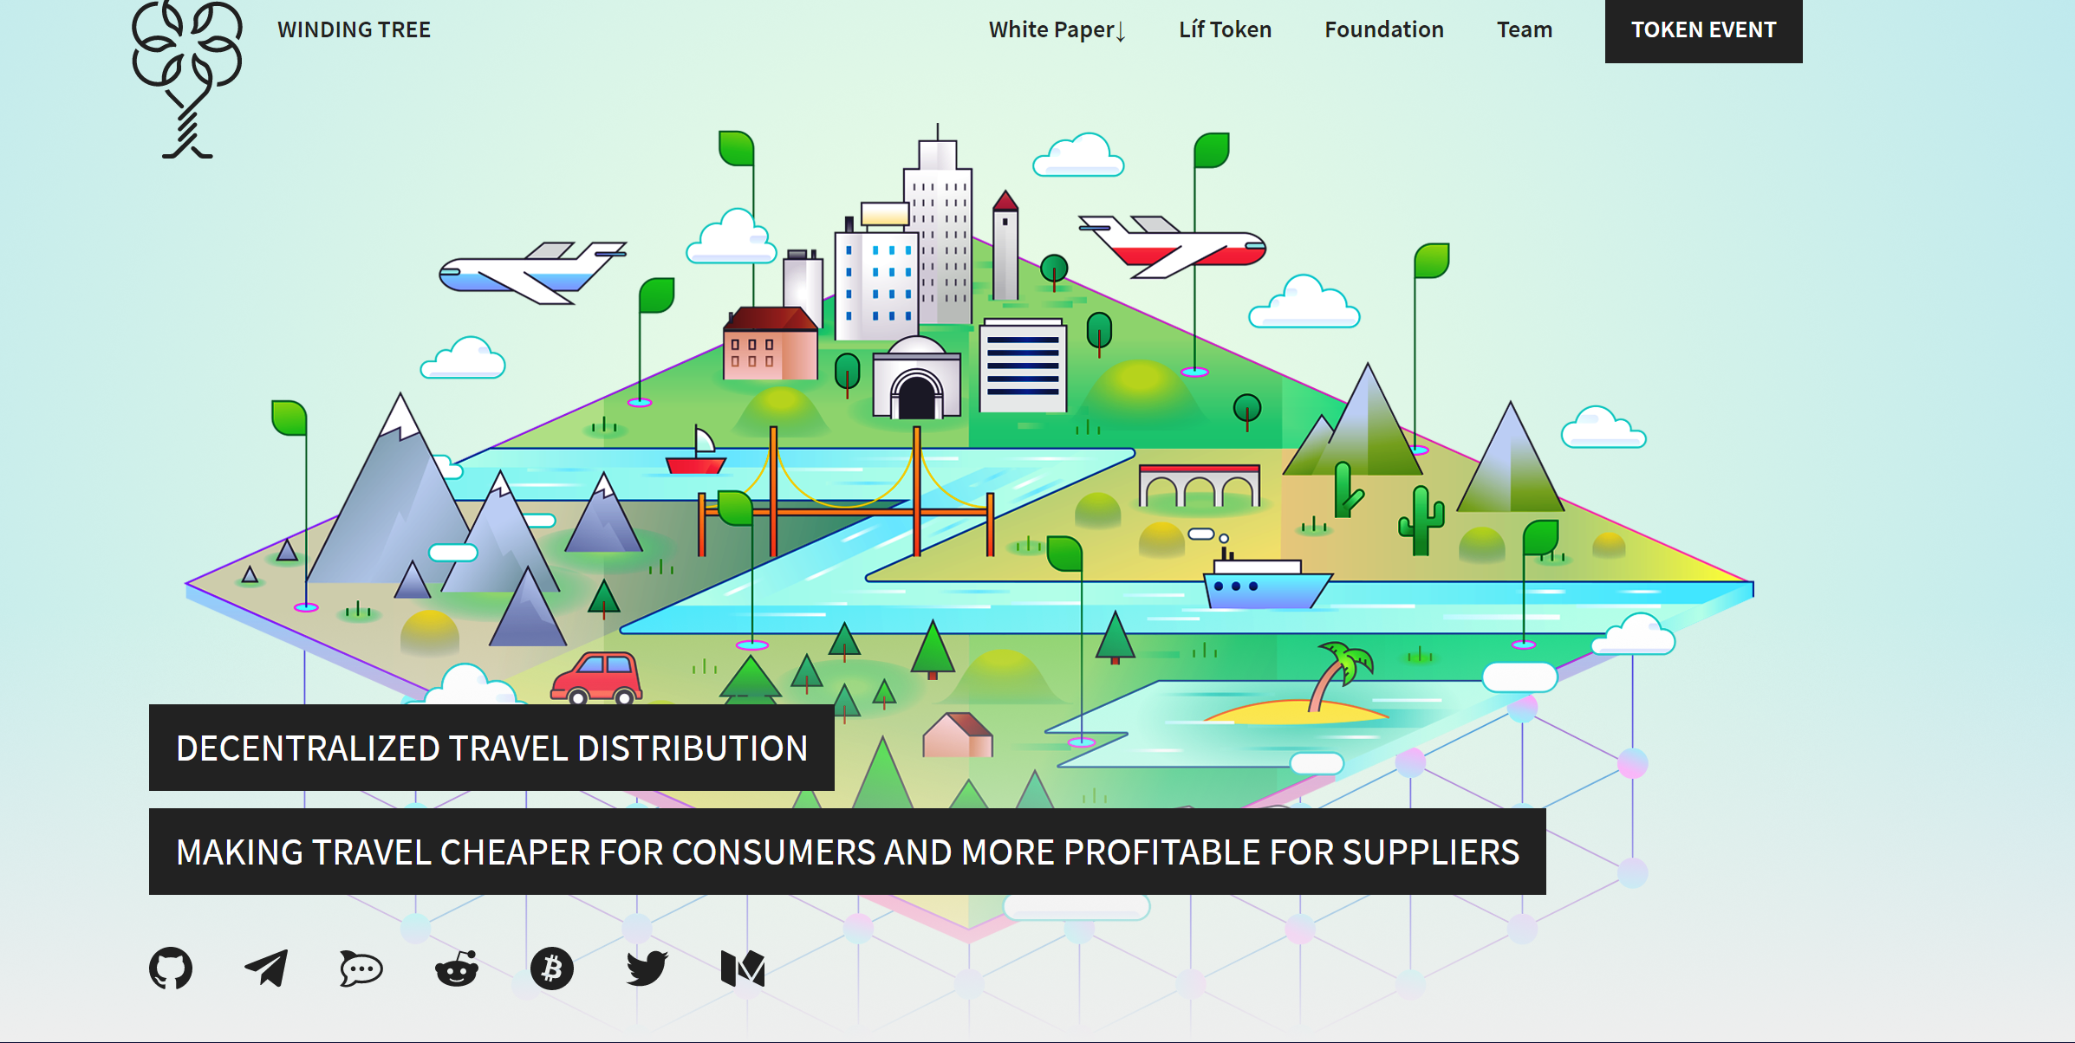

Slide 10
Firms | Business model | Market cap/ funding | Fees to supplier | Fees charged to consumers
AirBnB | "Online marketplace and hospitality service, enabling people to lease or rent short-term lodging. The company does not own any lodging; it is merely a broker and receives percentage service fees from both guests and hosts in conjunction with every booking." | $31Bª | Fees to hosts: 5 - 15%^{n} | Fees to guests: 3 - 5% + taxes^{n}
Winding Tree | "Blockchain-based decentralized open-source travel distribution platform." | $10Me | <1%^{q}

Slide 11
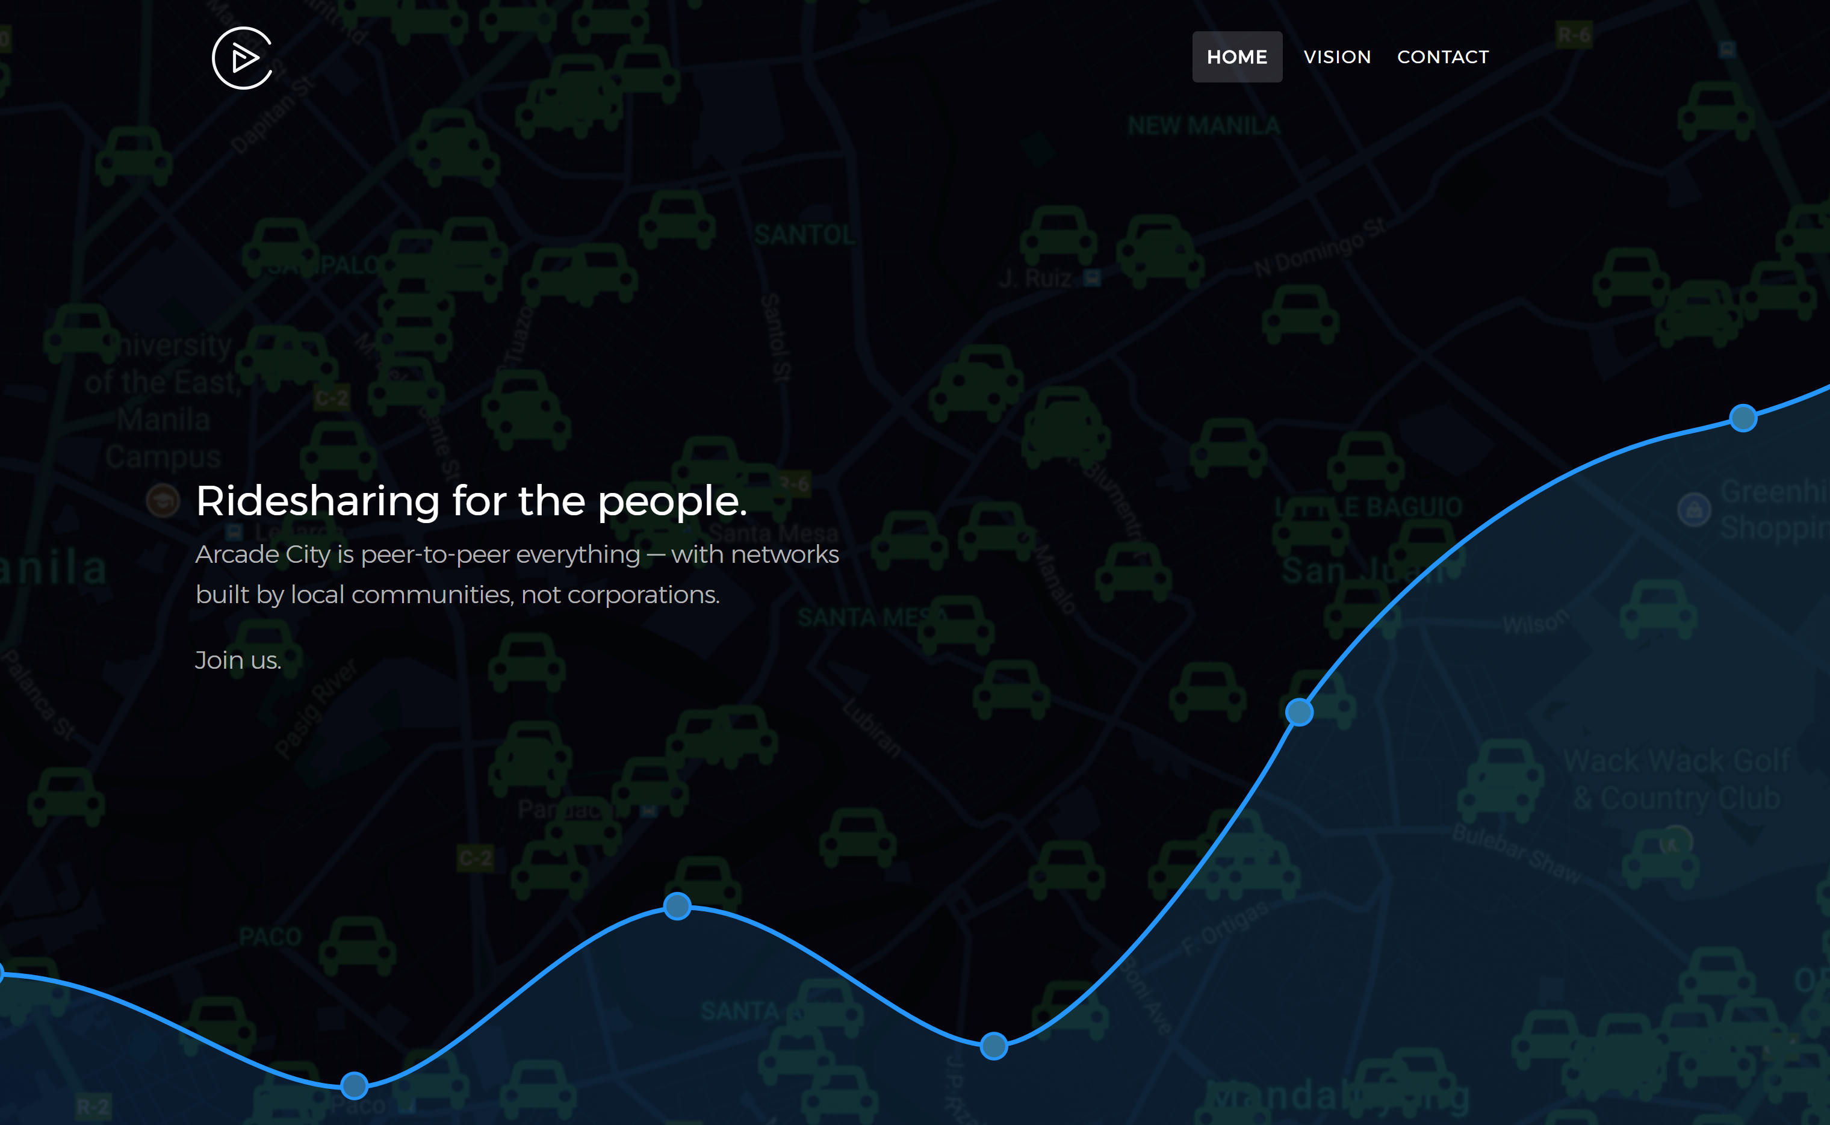

Slide 12
Firms | Business model | Market cap/ funding | Fees to supplier | Fees charged to consumers
Uber | "Uber Technologies Inc. is an American private hire company operating in 633 cities worldwide. It develops, markets and operates the Uber car transportation and food delivery mobile apps." | $70B^{g} | ~25% of total driver's revenue ^{r s} | -
Arcade City | "Ethereum-based ride sharing project." | $7,298M^{h} | Unique fee to drivers: 5%^{t} | -

Slide 13
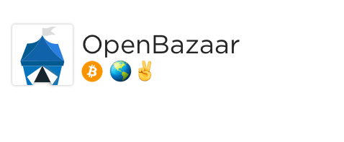
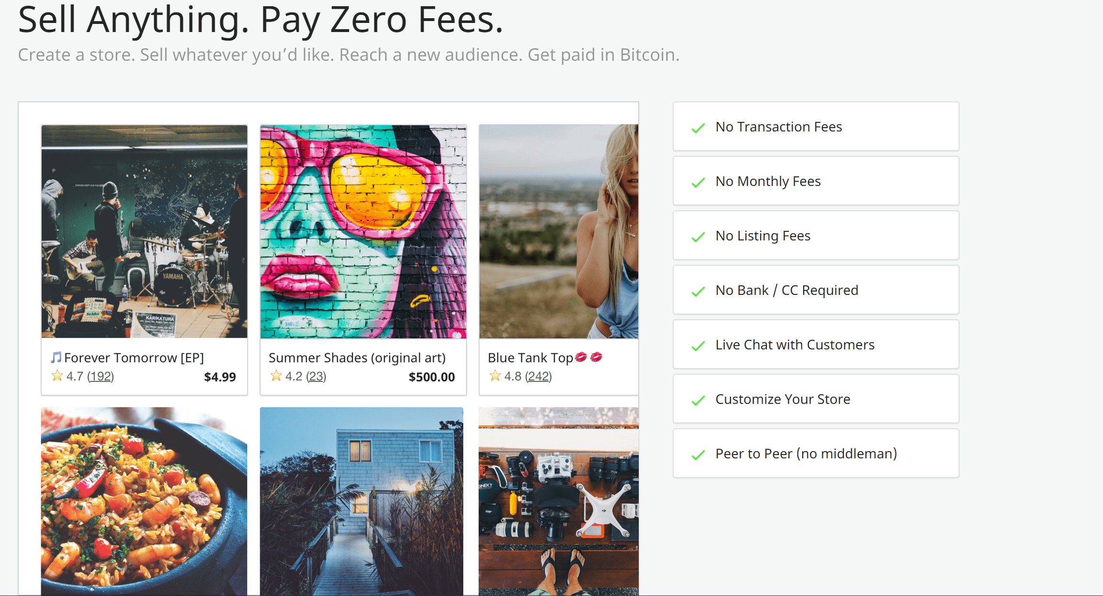

Slide 14
Firms | Business model | Market cap/ funding | Fees to supplier | Fees charged to consumers
eBay | "eBay Inc. is a global commerce leader including the Market-place, StubHub and Classifieds platforms. " | $41.528B^{j} | Standard selling fees: 10% (+ other fees) | -
OpenBazaar | "OpenBazaar connects buyers and sellers directly via a peer to peer network. Data is distributed across the network." | $4.2M^{k} | ~ 0% ^{x} ("Because there's no company or organization running OpenBazaar, there's no one to charge you fees to list your products and no one to register an account with".)

Slide 15
Internet networks (e.g., Airbnb) (but also Uber, Apple Store, Amazon, eBay, etc.)
Guest
Host
Airbnb
Guest
Host
Guest
Host

Slide 16
Blockchain network (e.g., Winding Tree)
Guest
Host
Guest
Host
Guest
Host

Slide 17
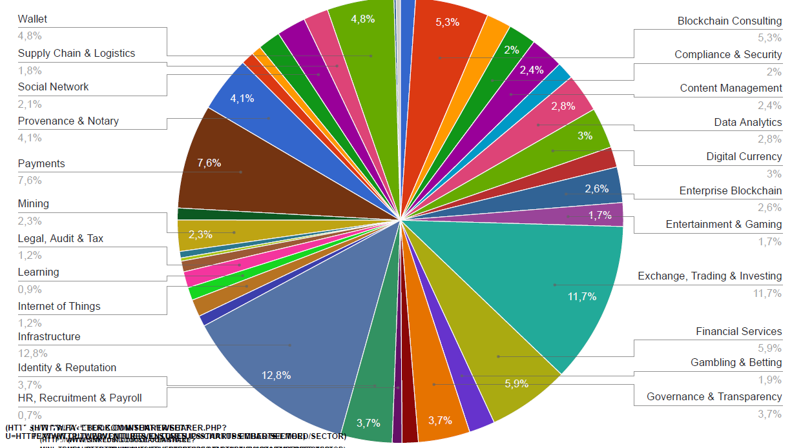
Possible applications https://outlierventures.io/startups/charts/

Slide 18
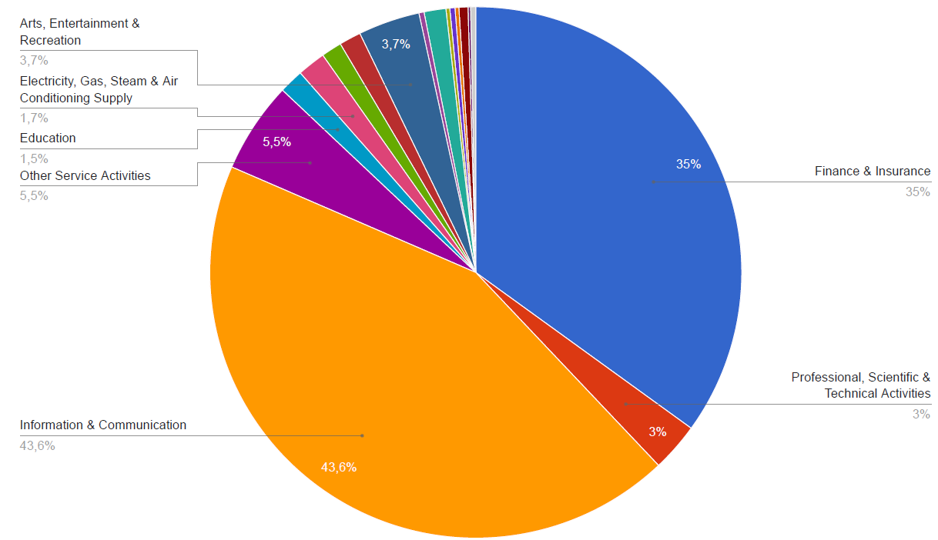
Possible applications https://outlierventures.io/startups/charts/

Slide 19
IBM wants Canada to blockchainify its weed industry
IBM is consulting British Columbia as the state prepares its new regulatory framework for the production and distribution of cannabis – and its advice is all based around the use of blockchain technology. (TNW, Nov. 6, 2017)

Slide 20
Huge promise, huge hype? 2-3 major problems:
“Scalability”
“Usability” =
= impact on transaction costs = comparative advantage of blockchain-enabled business models
“Organizational”: holdup & change in platforms

Slide 21
Blockchain contractual promise (“usability”)
Automatic contract completion & enforcement (“code is law”) & “transfer any kind of asset”
Without central agents for neither
Completion → │ “trust specialists” are
Enforcement → │ made obsolete

Slide 22
Contractual difficulties in blockchain network = sources of centralization
Guest
Host
Guest
Guest
Guest
Host
Guest
Host
Guest
Host
Impossible to complete contracts ex ante
Personal rights require reputation for enforcing “incomplete” dimensions
Real rights involve 3rd parties

Slide 23
I. Contracts are incomplete
More so the more qualitative the transaction. Ex:
ATM vs. home sharing
Airbnb as… referee
Ex post completion required → central agent
Palliatives
2-out-of-3 multisignature
Modularity in contracts simplifies and lowers costs
Artificial Intelligence would provide automatic ex post completion with “judgment”—but when?

Slide 24
II. Personal rights require reputation for enforcing incomplete dimensions
Identification + evaluation + accumulation
E.g., Ebay, Amazon, Booking, Trip Advisor, Michelin
→ central agent?
across DApps → Specific DApp or platform?
personally owned and controlled?
BTW, the Roman Census revisited (!)

Slide 25
III: Real rights involve 3rd parties & thus require neutral enforcer
More so the more durable and valuable the asset
FROM: low-value virtual assets (e.g., song)
TO: high-value land (optimal to have many rights on each asset)
For real (in rem) rights, blockchain would require:
universal blockchain with all in rem rights
now, taxes and possession often in rem even if unregistered
public intervention required
full individual responsibility, less “bounded” rationality

Slide 26
Conclusion: Disruptive, but not so widely
Not-so-drastic changes
Instead of decentralization, new private specialists → bottlenecks & value appropriation
Conventional public action
Public goods even at the platform level
Enforcement, esp. in rem
Freedom vs. responsibility conundrum
Investment
How much of a bubble? When will it pop?
Where? Protocol coins > app coins, bottlenecks

Slide 27
Thanks

