Slide 1
Contents
0. Kick-of sessions
  - Applying through real cases what was learnt in 4 trimesters
  - Identifying which additional tools we need to tackle them
I. Individual behavior (opening the “black box” on individuals)
  1. Role of rationality
  2. Managing incentives
II. Organization (the “inside” of firms)
  4. Markets & organizations. Divisionalization
  3. Markets & politics
III. Institutions (the “outside” of firms)
  5. Institutional support of private contracting
  6. The role of firms in society, CSR

Slide 2
Markets & Politics

Slide 3
Specialization & Exchange through Markets & Politics

Slide 4
Markets & politics
Substitutes: Economic decisions are made either by
  individuals contracting in the markets
  exercising (state, organizational) “political” power
Complements
  state power (e.g., the law) constraints and helps market contracting
  Does politics can also be seen as a market?

Slide 5
Objectives
Three views of the economic problem…
    Optimization (Robbins)
    Information (Hayek)
    Exchange (Coase)
… learn to:
  analyze how markets & politics resolve them
  understand how they complement each other
Notes:
5

Slide 6
Introduction: What’s the economic problem in Robinson Crusoe’s story?
Before Friday comes in?
  Optimization → Robbins: allocating scarce recourses…: what to produce, how, for whom?
After Friday comes in?
  Hayek: information: transmission + discovery
  Coase: transaction costs
    Coordination
    Motivation

Slide 7
Markets and politics:
The role of information
If the economic problem is to correctly allocate resources, what is required to solve it?
Who “should” decide on which univ. / school to go to? (E.g.: single-sex schools)
Who knows better about the different schools?
  Students, parents, teachers, planners, politicians?
Who has better incentives?
  For finding information? For deciding? For Innovating?
(Aside: Should these questions be posed in terms of “best” or in terms of “better”?)

Slide 8
On the nature of the economic problem
Reach specialization advantages (Smith’s “division of labor”)
  Comparative advantage → higher productivity
    Origin: previous investment
    Ambiguity of purpose: e.g., mafia
Obstacle: “transaction” (i.e., exchange) costs
  Coordination → information
  Incentive alignment → information asymmetry

Slide 9
“Market” = Price System + Market institutions
Price system = Microeconomic abstraction
  Calculating machine → allocation of resources
Information processing
  Prices have nice properties as signals: minimal, selective & relevant information
  Information has to be discovered
Market institutions, at least:
  Property rights, both allocation & enforcement → incentives
  Law & independent judiciary → transaction costs

Slide 10
Promises as objects of exchange → Information asymmetry → cheating
How to cope with it?
Mistake: to take as a default the sequence
self-interest → opportunism → “safeguarding”
Need of a broader view instead:
  Safeguarding = “farsighted contracting” à la Williamson
  Screening types when previous commitment is viable
  Providing cooperative starting points → motivate employees to start cooperating
  “Educating” to mold types, viable at least at social (including firm) level

Slide 11
Examples for discussion:
How does people decide on…?
… life expectancy?
  How do we decide? Individually? Socially?
  Is there an optimal level? Is the maximum level optimal?
    Individual = market? “Social” = political?
    Are they the same? Even for vaccination?
… education?
  How should decisions be made? Individually? Socially?
  What is the optimum? Is the maximum the optimal level?
  Does the optimal way of deciding on these matters change between basic education and university education?
Notes:
11
11

Slide 12
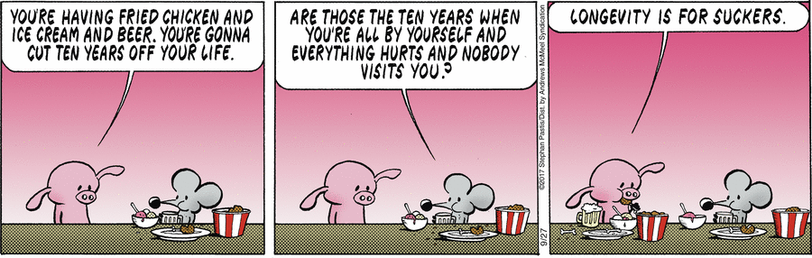
What is your optimal life expectancy?

Slide 13
Example: Life expectancy, shorter in the USA than in Spain
Higher in the USA or in Spain? →
Notes:
13
13

Slide 14
Why is life expectancy shorter in a richer country such as the USA than in Spain?
 | USA | Spain | Korea
Life expectancy (years) | 79.3 | 82.8 | 82.3
HALE (Health-adjusted years of life expectancy) | 69.2 | 71.9 | 73.2
Reduction in years | 12.74% | 13.16% | 11.06%
GDGpc (PPP) | 57,294$ | 36.451$ | 37.948 $
GDPpc / Years | 722 $/year | 440 $/year | 461 $/year
GDPpc / HALE Years | 828 $/year | 507 $/year | 518 $/year
Sources: GDP, World Economic Outlook Database, October 2016, International Monetary Fund. Life expectancy, "World Health Statistics 2016: Monitoring health for the SDGs Annex B: tables of health statistics by country, WHO region and globally". World Health Organization. 2016.

Slide 15
Example: Life expectancy, shorter in the USA than in Spain
Higher in the USA or in Spain? →
Is higher = better? What is the optimal life expectancy?
  Individually?
  Socially?
How is life expectancy “decided”?
  I.e., which decisions influence it?
  Might there be decision failures
    in the USA?
    in Spain?
Notes:
15
15

Slide 16
A sample of decisions affecting life expectancy
Market decisions | Political decisions
Production & advertising tobacco Smoking, drinking Driving speed Purchase health insurance Diet, etc.,… | Tax & regulation on tobacco No smoking rules Traffic lights, radars, fines “Free” mandatory healthcare Taxes on fat, sugar, etc.,…
Notes:
16
16

Slide 17
Three questions to cover next
How do both decision systems work?
Are there systematic “failures” in both?
How do both decision systems interact?

Slide 18
Question 1:
How do markets & politics work?
How do they differ?
What are their comparative advantages?

Slide 19
How do we decide through markets & politics?
Markets
  Voluntary
  Decentralized
  Direct decisions by resource owners—property rights
  Weighting of information according to individuals’ participation in the market
Politics
  Coercion
  Centralized
  Representative decisions by citizens—political rights(e.g., votes)
  Weighting of information according to political rights

Slide 20
Robbins, Smith, Hayek and Coase on the economic problem
E.g., what is their main or typical economic problem with respect to life expectancy?
  Allocating scarce resources among alternative uses (Robbins) →
  Specialization (Smith) →
  Hayek: What & where is the relevant information?
    “Scientific” or general info? “Particular” or specific info?
    Is it applicable to COVID-19? Google searches of fever → next slide
  Coase: Incentives behind info & allocation, e.g.:
    Externalities of smoke
    Allocation of property (decision) rights to smoke / impede smoking
    Bargaining possible? Socially through norms?
Notes:
20
20

Slide 21
Hayek 1945
Fundamental economic problem: use of information
  “Scientific”
  “Specific” (“particular circumstances of time and place”) = costly to transfer
    Main advantage of markets over “planning” (i.e., politics)
    E.g., Soviet Union: planning for industrial/consumer goods
Big absence: Property rights → Coase 1960
  E.g., internal markets do elicit specific information but, lacking property rights, often do a poor job

Slide 22
Examples of Hayek’s types of info:
(1) Soviet economy differential performance
First decades:
  Performed less badly when focused on commodities (steel, coal, electricity, etc.)
Last decades:
  Seemingly failed more when tried to produce consumption goods
Arguably, consumption goods require processing more specific information

Slide 23
Examples of Hayek’45 types of info:
(2) On “particular circumstances” RE covid fever

Slide 24
(3) Examples of Hayek’45 types of info:
‘Scientific’, easy-to-aggregate information

Slide 25
Coase 1960
Coase: Incentives behind info & allocation, e.g.:
  Externalities of smoke
  Allocation of property (decision) rights to smoke / impede smoking
  Bargaining possible? Socially through norms?
Notes:
25
25

Slide 26
Question 2:
Are there systematic “failures” in markets & politics?
Do these failures share common elements?
Are they somehow complementary?
Is there a basis for effectively combining markets and politics (question 3)?

Slide 27
2. Types of “failures” in both markets & politics: both “fail” in reaching their optimizing goals
Rationality → Individual → Collective
& information optimum optimum

Slide 28
Market “failures”
Rationality → Individual → Collective
& information optimum optimum
Market ? ?

Slide 29
Market “failures”
Rationality → Individual → Collective
& information optimum optimum
Market - incapacity - info. deficit
- info asymmetry

Slide 30
Market “failures”
Rationality → Individual → Collective
& information optimum optimum
Market - incapacity - externalities - info. deficit - public goods
- info asymmetry - monopoly
Notes:
In a speculative bubble, are there negative externalities? One may argue that noisy traders worsen the informative value of prices. Them informed traders contribute a positive externality?

Slide 31
Market and political “failures”
Rationality → Individual → Collective
& information optimum optimum
Market - incapacity - externalities - info. deficit - public goods
- info asymmetry - monopoly
Politics ? ?

Slide 32
Market and political “failures”
Rationality → Individual → Collective
& information optimum optimum
Market - incapacity - externalities - info. deficit - public goods
- info asymmetry - monopoly
Politics - minors, herding
- decentralized
- agency

Slide 33
Market and political “failures”
Rationality → Individual → Collective
& information optimum optimum
Market - incapacity - externalities - info. deficit - public goods
- info asymmetry - monopoly
Politics - minors, herding - bwn political entities
- decentralized - uninformed voting
- agency - of parties, media, etc.
Notes:
Funk on voting: less when possible to argue voted by mail

Slide 34
Ex. of failures in markets & politics
(in green: topic on institutions)
Market failures
  Rationality → no even individual optimum (addiction, children)
  Break b/w individual and social optimality
    Information asymmetries
      Transaction costs (e.g., Akerlof lemons problem)
    Externalities (e.g., pollution)
      Public goods (e.g., army)
      Monopolies (e.g., utilities)—unambiguous role of competition?
Political failures
  Rationality (how do we take sides in politics? Beliefs?)
  Break b/w individual and social optimality
    Information asymmetries
      Agency (representation)
    Externalities
      Public goods (poor weighting of info)
      Monopolies (e.g., parties, barriers to entry)—ambiguous role of competition?
Notes:
Inevitable agency is opposed to contractual (agreed by parties) agency in markets

Slide 35
Failures in individual rationality
How can we correct failures of rationality in people who are inclined to be violent?
Can we apply this criterion to other failures on rationality?
  Example: If we protect “weak” parties to a contract, what incentives do they have to inform themselves & stop being weak?
Is it easy to distinguish between strong and weak parties after the event?
  E.g., today’s victims of fraud are yesterday’s big investors
Who is most rational – the consumer or the citizen?
  E.g.: Speed limit of 110 km/h on highways
Notes:
35

Slide 36
More on political failures
Behavioral limitations: e.g., chauvinism
Representation → Agency w. self-interest & info asymmetry → opportunism, corruption
Collective action → misinformed voters, lack of control, prevalence of concentrated, minority interests
Tradeoffs w.r.t. to competition on stability?
  E.g., how is politics coping with the competition brought by globalization and immigration? Assuming homo sapiens, it is a tricky issue
Notes:
Emphasis on representation → politicians’ responsibility
Emphasis on collective action → citizens’ responsibility

Slide 37
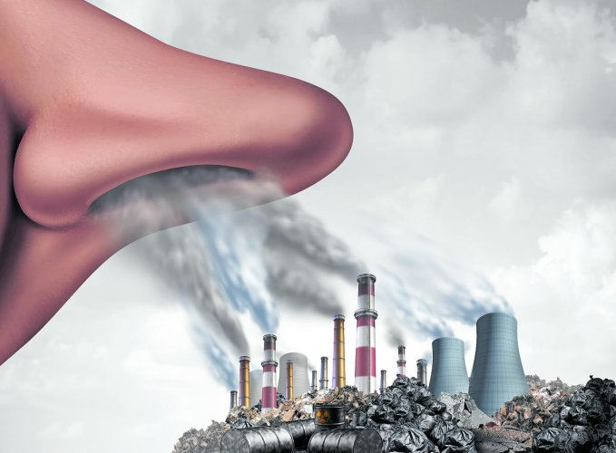
Externalities
Individual optimum ≠ collective optimum

Slide 38
Examples of externalities & public goods
Is the number of pollinating bees optimal?
Why do streets get congested?
Why fish stocks get depleted?
  Why is this not the case in Scotland?
Why is the air polluted? What can be done?
Would it be enough to define and allocate property rights? What does Varian omit?
Notes:
38

Slide 39
The Coase ‘Theorem’
If transaction costs...
  are zero, initial allocation of rights does not affect
    final allocation of resources or
    production level
  are positive, allocation and production are affected
  impede trade, final allocation determined by initial allocation
Example: Noisy firm causes externality on neighbor
  With positive transaction costs political decisions should focus on reducing transaction costs by
    Clarifying allocation of property rights (who has right to what) and
    Securing their enforcement (no expropriation)
Notes:
1960: naive regulatory context…

Slide 40
Example: Noisy firm and neighbor
Profits for firm* | Losses for neighbor* | Initial allocation of rights | Firm’s decision | Compen-sation, C | Final allocation of rights
40 | 60 | Neighbor | Closes to avoid paying compensation 60 > 40 | 0 | Neighbor
 |  | Firm | Closes because neighbor would compensate | 40 < C< 60 | Neighbor
60 | 40 | Neighbor | Continues after compensating the neighbor | 40 ** | Firm
 |  | Firm | Continues | 0 | Firm
* Costs and benefits in current values
** Assuming that the legal system considers damages as an upper limit of compensation

Slide 41

Widespread problem
E.g., “Murdered for eating popcorn while watching ‘Black Swan’” (Riga, Feb. 22, 2011)

Slide 42
Analysis of the Riga crime
Externality failure: noise from eating popcorn
  Rights (“Property rights”):
    To eat popcorn
    To not be disturbed by someone eating popcorn
  Allocation of rights clear: popcorn sold in the premises
  But transaction costs prohibitive. Really?
    “negotiation” even causes a negative externality
Rationality failure (?)
  Cost of going to prison is high & movie not watched.
  Satisfied a wish for revenge
    Does it work as deterrence?
    No failure if repeated interactions?
Notes:
42

Slide 43
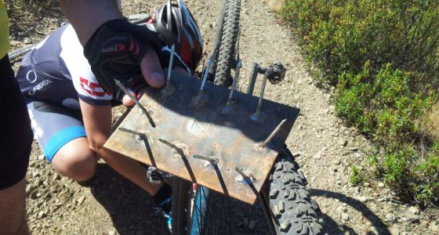
Why does it fail?
Landowners vs. mountain bikers
Property rights?
Externalities?
Transaction costs?
Similar cases with bikes in cities’ sidewalks?

Slide 44
Transaction costs & property rights
Externalities
Coase Theorem: zero TC → irrelevant
What is Coase’s contribution to the “economic problem”?
  Property rights →
  incentive to produce and use information
  Institutions →
  reduce transactions costs → specialization → productivity
  Comparative analysis of realities (politics vs. markets, public/private provision, alternative regulations)
    mainly, compare current situation with possible reforms
Notes:
44

Slide 45
Why important?
Basis for effectively tackling question #3
(the interaction bwn markets and politics)
Before: narrow view of regulation
After Coase:
  Wider view
    Focus on transaction costs & property rights → market-enabling regulation (e.g., pollution permits, mortgage registers)
    Econ. analysis of law: some examples below
  Comparative emphasis instead of proposals to tax or regulate market failure with idealized regulation

Slide 46
Externalities are reciprocal
Nonsmokers on smokers
Bicycles on cars
Pedestrians on bicycles
Punctual students on latecomers
More examples?
Notes:
46
Tough to swallow bc of endowment effect

Slide 47
Reciprocity in externalities
Notes:
47

Slide 48
Sources of transaction costs
Unclear allocation of property rights. Examples:
  Simple: bicycles in sidewalks, water of Ebro river (numbers below)?
  Complex: use of land as collateral for credit (mortgage)
Number of parties
  Especially, with open numbers
  Palliative: legal fictions—E.g., firms as “nexus of contracts”
Constraints on trade
  Information asymmetries
  Wealth constraint
  Endowment effect and other cognitive biases
    Example: few reallocating agreements after litigation
    Biological rationale behind possessory instinct
  Artificial barriers to trade
    Licenses for taxis, pharmacies, musicians, TVs, etc.

Slide 49
Some numbers on Catalan Water
Scenarios: | Conservative | Realistic | Units
Rice production in Ebro Delta | 150,000 | 135,000 | Tons
Price per Ton | 750 | 500 | USD / Ton
Estimated value of production | 102.27 | 61.36 | M. € (1 € = 1.1 USD)
Water needed for producing 1kg of rice | 2,000 | 4,000 | l. of water/1 kg. of rice
Water required for total rice production | 300 | 540 | Hm³
Average price of water in BCN | 2.00 | 4.00 | €/m³
Estimated cost of water used for rice | 600 | 2,160 | M. €
Estimated welfare loss (value of rice minus cost of water) | -497.73 | -2,098.64 | M. €
Pro memoria:
Population of CAT | 7.566.000 |  | hab.
Consumption per capita | 117 |  | l./day (ACA, GenCat)
Total | 323 |  | Hm³ / year

Slide 50
Classic solutions to different ‘externalities’:
(a) “The Fable of the Bees”
Pollination as a positive externality
Contracting bees for pollination
  Visit http://www.beepollination.com/
    “We provide services to California. Almond growers by locating strong, healthy beehives for almond pollination.
    We also provide services to Beekeepers by locating suitable almond contracts for their particular bee business.”
  See this pollination agreement:
    “The beekeeper shall supply the grower with _______ hives (colonies) of bees to be delivered to the (cucumber, watermelon field, etc.) as follows: ....”
Vertical integration: is the firm by far the main solution?

Slide 51
(b) “The Lighthouse in Economics”
Public goods → market underprovision
  No rivalry b/w users
  Impossible to exclude users
  e.g., national defense
  See http://en.wikipedia.org/wiki/Public_good
Empirical evidence on lighthouses (often used in textbooks to illustrate public goods)
  Coase art.: exclusion → “club” good: private building and operation of lighthouses
  Marginal cost = 0 →
    “Inefficient” if price > 0?
    “Inefficient” with respect to what? Need to compare real options
  But without regulation (i.e., licensing of lighthouses, enforcement of tolls), would private provision work?

Slide 52
(c) The “Tragedy of the Commons”
Unrestricted access to a resource → over-exploitation
  E.g., ocean fishing, air pollution, road congestion, etc.
Reason: individual benefits, social costs
Solutions:
  exclusion (private or communal property) & trade
  regulation
Exercise
  Visit www.perc.org on the free-market environmentalism
Notes:
Skip-seen in Micro

Slide 53
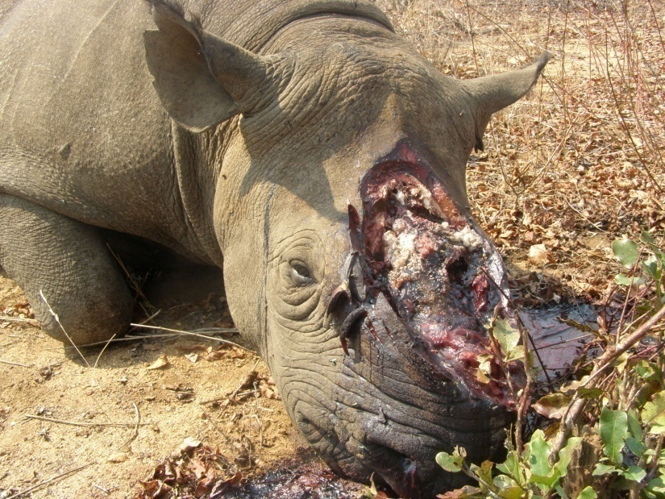
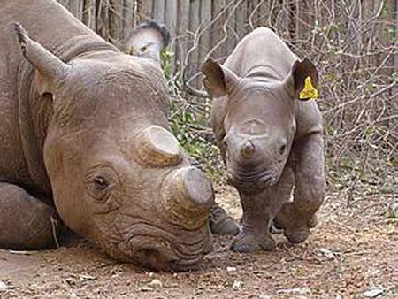
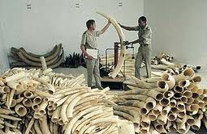
Poaching wildlife
Why? What to do?
  Key variables?
Does allocation of property rights fully solve the problem?

Slide 54
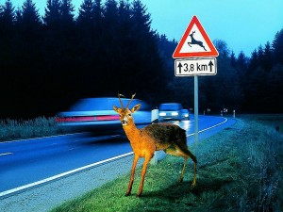
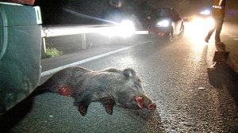
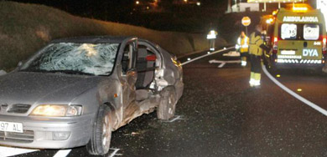
(d) Allocation of liability
“If you run over a wild boar, you’re guilty”
(El País, Feb 13, 2014)
Notes:
54

Slide 55
(d) Allocation of liability
What are the consequences that the law makes either the land (or animal) owner or the driver (or car owner) ‘liable’, i.e., legally responsible?
  Levels of accidents, boars, cars, fences, speed, precaution?
Will such levels be affected by allocation rule?
  Are transaction costs high? (sensible here?)
  If high, who is in the best position to decide?
  Optimal for: abandoned pets? Wild animals? In hunting areas? In highways?
  Changes with technology (chips defining pets’ ownership)
Covid pandemic
  Who should bear lockdown costs? Mandatory vaccination?
Notes:
55

Slide 56
“Anticommons”
Too many restrictions to access a resource leads to underutilization
Misleading analysis:
  The problem is not too many “property” rights but
  High costs of gathering the “consent” of rightholders
    The case of mortgages … →

Slide 57
Summing up lessons from Coase
Not the so-called Coase Theorem: if TC = 0,
  trade → no externalities
  irrelevance of initial allocation of rights
    reciprocity
Focus on transaction costs → law & firms
  Role of contracting: market failure = business opport.
    integration to internalize externalities (firms)
  Role of state
    reducing transaction costs to enable trade (law in #5)
      enabling markets (e.g., pollution permits)
    allocating rights if TC too high (bikes in sidewalks)
Comparative analysis of real alternatives → Q3

Slide 58
Question 3:
How do markets & politics interact?
Two steps:
1) How to compare markets & politics
2) How to develop fruitful interactions

Slide 59
3. Interacting & evaluating markets & politics
Forget ideal performance → examine real performance
  We should not compare (as progressives & socialists often do)
    A real, imperfect market, governed by self-interest
    An ideal, perfect politics governed by angels
  Neither should we compare ideal markets & real politics (as libertarians do?)
Use consistent behavioral assumptions. Avoid assuming, e.g.,
  selfish market participants (causing market failure) but altruistic regulators (supposed to solve it)
  Ignorant voters but wise market participants
Focus on how markets and politics interact
  Are failures driven by politics, markets, or… both? → Cases
  Can we learn from markets to make politics more efficient? →
    Next, cases
    Topic on divisionalization
  Can we use politics to get more efficient markets → topic on institutions

Slide 60
Can we learn from markets to make politics more efficient? More exs.:
Managing instincts
  Herd instinct? Ownership? Reciprocity? Not necessarily bad: emotions ‘solve’ the collective action problem… for good & bad. Ex., patriotism: need to ‘educate’ it, as any other emotion
Managing information for decisions—e.g., “gerontocracy”
  Do retirees vote as an interest group? On what?
  Should babies have a vote? Those over-16s? Their parents? Immigrants? Only taxpayers? Should pensioners have half a vote?
Managing information asymmetry
  How can we improve citizens’ information on
    Value of public services? Their costs?
  Effects on transparency of public expenditure of
    “Shadow invoices”? Withholding taxes?
Managing agency costs in politics
  Should majorities rule unconstrained? Do constitutions make sense?
  Why to have separation of powers? Should they fight each other?
Notes:
60
Instincts: from topics 1 6 2
Info: form Hayek
Rest: form Bus Econ

Slide 61
How do we value markets and politics?
Which schools do politicians choose for their children? Is this relevant?
Who do we want to choose the schools for our children in… Spain, today; Denmark, today; Iran, today; Spain, in 1965?
Do politics / markets decide by majority vote?
How does personal wealth affect decision rights in markets and politics?
Notes:
61

Slide 62
Markets & politics as alternative solutions
Who does the market compete against?
Are both markets and politics social decision-making processes?
Easier to see politics as social decision-making?
Notes:
62

Slide 63
Comparing Markets & Politics
Which markets and which politics?
  Bad vs. ideal? Ideal vs. bad? Real vs. real?
Danger: implicit asymmetric assumptions on behavior, information, competition
Food for thought:
  Identify examples of each type of comparison in the media and TV debates
  Who does generally win when decisions move from the market to politics? And vice versa?

Slide 64
Managing information asymmetry in markets & politics. Cases:
“Vodafone convinces the advertising regulator to oblige all cell phone cos. to include Value Added Tax (VAT) in their advertised prices” (Feb. 7, 2014, http://ow.ly/tntXN)
  Commercial market
    Are there info. asymmetries? About prices? In long run?
    Switching costs? Incentives to exploit them?
    Does it change if prices were Vodafone, 121€ (=100+21% VAT), and competitor 108,9 = 90+18,9 VAT (announcing for 90€) or 127 = 105+22 VAT (announcing for 105€)?
  Politics: Are there info. asymmetries?
    Which solution makes taxes more or less visible?
    When taxes are more visible, how do politics change?
  Interaction bwn info asymmetry in market & politics
Notes:
64

Slide 65

The price of electricity before Ukraine war:
“Taxes”
See this for a critique

Slide 66
On the price of electricity
Has the price of electricity risen?
Do we finance renewable energies with transparency?
Costs, years ago:
  Nuclear, 44 € / MW/h (*)
  Coal, 72 € / MW/h (*)
  Fuel-gas, 69 € / MW/h (*)
  Wind, approx. 90 € / MW/h
  Photovoltaic, approx. 430 € / MW/h (now, much lower)
    Sources: (*) National Energy Commission, 08 http://www.cne.es/cne/doc/publicaciones/cne82_08.pdf
Notes:
66

Slide 67
3. Taxes on houses
Two main taxes
  Tenure taxes (IBI)
  Transfer taxes (ITP + plusvalías [esp. w. inflation])
Levels?
  Spain: low IBI, high ITP (mainly in CAT, 10-11%) →
  US: high IBI, low ITP (less than 1%; often, 0)
For the same total tax, high ITP & low IBI will:
  affect housing market?
  labor market?
  distribution of tax burden?
  asymmetry on taxation?
Why? Social structure? Cause or consequence?

Slide 68
Taxes and home transactions
 | BCN | Madrid
Transfer tax (ITP) | 10-11 | 6 | %
Empty houses | 9.33 | 6.34 | %
Average turnover of flats, every… | 46 | 30.5 | Years
Difference in turnover is equivalent to 87% of greater tax collection in CAT

Slide 69
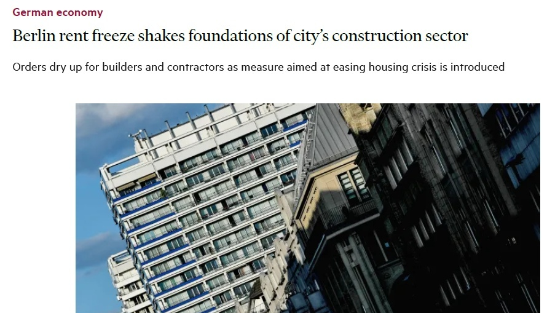
Regulating the home rental market

Slide 70
4. Covid-19 case (Feb. 2020)
Decisions
  Markets: travel, Mobile, etc.
  Politics: Preventive health care via quarantines, curfews, travel bans
Information structure: availability (scientific, specific), asymmetry
Cognitive assumptions
  rationality or emotions? Which emotions? fear, herding, risk & loss aversion
  selfishness or altruism?
Market or political failures ? E.g., externalities in both:
  BCN mobile Intl. Fair, travel → spread of
  Chinese silence → disease
  Political failures in agents’ incentives
    public health officials and their two types of mistake
      do they have symmetric incentives?
      China, BCN vs. USA or Italy (?)
  How are journalists reporting on the causes of deaths?

Slide 71
4. Covid-19 market and political failures
Rationality → Individual → Collective
& information optimum optimum
Market - incapacity - externalities - info. deficit - public goods
- info asymmetry - monopoly
Politics - emotions - bwn political entities
- herding - “expressive” voting
- agency - of parties, media, etc.

Slide 72
5. Disentangling market & political failure: the 2008 Crisis
Mixed nature of financial, heavily regulated markets
  Monopoly of money
  Role of central banks
    Lender of last resort
    Deposit insurance → moral hazard, risk shifting
    Price fixing: interest rate
      Example: in a bubble, interest kept too low (Spain, -3%) → How does this distort lending decisions?
  Mortgage market:
    Subprime lending partly mandated by law in the US, to the extent lenders had to grant % of loans to people below average income
    Home buying often subsidized with tax deductions (Spain)
    Publicly owned main lenders (Spanish “Cajas”)

Slide 73
6. A case on regulation:
Stores’ opening hours
Possible market failures
  Externalities?
  Monopoly?
  Public goods?
  Rationality?
Possible political failures
  Preferences’ transmission?
  Regulatory capture?
  Who benefits?

Slide 74
Bonus track:
Applying insights from previous topics
We have seen
  Bounded rationality: e.g., limited “steps of reasoning”
  Role of emotions: e.g., voluntary cooperation, strong reciprocity overcoming collective action
  Herding behavior: does it influence social change?
Do we define fairness in equal or in proportional terms?
  Correlates with economists’ normative (what to do) and positive (how things are) positions (see Randazo & Haidt’s clipping, next)
Role of culture, values and beliefs in society?
  Possibilities of markets and institutional reform such as, e.g., labor market liberalization, stronger competition in politics
  Cultures and values, a hard constraint, at least in the short term?

Slide 75
Example: Demonstrations
Cognitive patterns (from Topic 1)
  Herding?
  Perception of the mass as the majority?
  Do we have a worse perception if demonstrators are “from the other side”?
Do they cause external effects? In politics?
  Are they positive? How are they taken on board? Subsidies?
  Are they negative? How are they taken on board? Responsibility?
Competition:
  Do they reduce entry barriers? Do they strengthen minorities?
Regulation: Why so different from one country to another?

Slide 76
Note that the following slides in this PPT are not discussed in EOM/EIM courses at UPF

Slide 77
Organization as solution to economic problem: The nature of the firm
Why do organizations (firms) exist?
Minimization of transaction costs
  There are not market failures but business opportunities—e.g. Carmax
  Other ‘explanations’ do not explain—e.g., economies of scale can be contracted
    example: trucking: intermediaries reach economies of scale and network, specially with respect to returns, but they contract in the market with owner-operator
  But within-firm exchanges also suffer transaction costs → …

Slide 78
Transaction costs are present in both organizations and markets
A familiar example:
  Babysitting by older child or by hired person → different exchange (coordination and motivation) costs are present in each solution, but both are positive in both cases
“Make or buy” decisions in a firm:
Performance and organizational choice:
For each level of x, firms choose the organizational form that optimizes performance. In principle, only these optimal choices are observed—for instance, vertically integrated units when x > xo.

Slide 79
Firms as nexus of contracts
Manager Z
Government
Firm A
Individual X
Firm B
Individual Y
Individual M

Slide 80
Firms as nexus of contracts
  Nexus, legal fiction → Reduce cost of transacting
  Contracts or hierarchies?
    True: Many contracts in the firm are relational →
      they define “hierarchies” → resources allocated by command, not by agreement
    But these contracts are voluntary, defining such hierarchical structures
      Hierarchy = ex ante voluntary allocation of rights asymmetrically to create a private legal order in which to complete & enforce contracts ex post
    Examples:
      labor contract
      franchising

Slide 81
Objectives of the firm
Individuals have objectives—firms do not
  Firms (as well as markets) just “behave” as a consequence of individual decisions pursuing these objectives
  They reach equilibriums, more like markets than individuals
Profit maximization
  Also an abstraction, an analytical tool
  Profit maximization as a competitive constraint, not an objective
    Competition → only firms with adaptive decisions will prosper and survive
    Competition also in political market (e.g. subsidies)
Consequences for strategic management:
  normative: what “the firm” should do?
  positive: why the firm is behaving in a certain way?
  Are firms “rational”? Do they commit suicide? Why?

Slide 82
Boundaries of the firm
The concept of “boundary” in firms and markets
  Market’s boundaries? → Useful to study the economy
  Firm’s boundaries? → Useful to study the market
Cases
  McDonald’s
  Trucking & construction
  Resale price maintenance
  ‘Pampered for free’:
    Firms are not necessarily the relevant competitive unit for competition policy? (see below)

Slide 83
Pampered for free
RETAILERS

