Slide 1
Institutional support of private contracting
© Benito Arruñada 1999, 2024

Slide 2
Previously… Both market & politics “fail”
Rationality → Individual → Collective
& information optimum optimum
Market - incapacity - externalities - info. deficit - public goods - asymmetry, etc. - monopoly, etc.
Politics - emotions - bwn political entities - herding - “expressive” voting - agency, etc. - of parties, media, etc.
Notes:
Maladaptation hypothesis

Slide 3
Previously… 3. Interacting & evaluating markets & politics
Forget ideal performance → examine real performance
We should not compare (as progressives & socialists often do)
A real, imperfect market, governed by self-interest
An ideal, perfect politics governed by angels
Neither should we compare ideal markets & real politics (as libertarians do?)
Use consistent behavioral assumptions. Avoid assuming, e.g.,
selfish market participants (causing market failure) but altruistic regulators (supposed to solve it)
Ignorant voters but wise market participants
Focus on how markets and politics interact
Are failures driven by politics, markets, or… both? → Cases
Can we learn from markets to make politics more efficient? →
Next, cases
Topic on divisionalization
Can we use politics to get more efficient markets → topic on institutions

Slide 4
Institutional support of private contracting

Slide 5
Outline
Contractual problem (1)
Solutions
Private “ordering”
basics (2)
cases (3)
Public “ordering”
law & legislation (4)
judges (5)
Interactions (6)
Values & institutions. The case of Spain (7)

Slide 6
1. The contractual problem
In microeconomics, we assume one-dimensional product s(the “x” in the horizontal axis) but most trade is about... multiple promises

Slide 7
Spot transaction: single moment in time
 | Contract & bilateral performance

Slide 8
Most transactions: deferred performance
Contractual commitment Ex ante |  | Contractual performance Ex post → last “move”

Slide 9
Potential traders face two problems:
Finding out the efficient exchange (production—“size of pie”: information)
How to find the optimal trade in any contingency? → How to contract so many contingencies? Ex.:
When? Ex ante, ex post (relational contract)
How? Contract clauses & legal rules
By whom? One party, all parties, third parties
Enforcing the agreement (distribution—“splitting the pie”: enforcement)
How? = By whom? One/parties (future trade), 3rd party (judge), other market participants (reputation)
Notes:
9
Compare private / public ordering in completion and enforcement

Slide 10
Problem #1: Information Given the huge number of possible contingencies ex post, how do parties ensure optimal trade?
?
?
?
?
?
Contractual commitment Ex ante |  | Contractual performance Ex post
Notes:
10
Derecho Romano, economía de Akerlof, Coase

Slide 11
Potential traders face two problems:
Finding out the efficient exchange (production—“size of pie”: information)
How to find the optimal trade in any contingency? → How to contract so many contingencies? Ex.:
When? Ex ante, ex post (relational contract)
How? Contract clauses & legal rules
By whom? One party, all parties, third parties
Enforcing the agreement (distribution—“splitting the pie”: enforcement)
How? = By whom? One/parties (future trade), 3rd party (judge), other market participants (reputation)
Notes:
11
Compare private / public ordering in completion and enforcement

Slide 12
Problem #2: Enforcement Deferred and asynchronous performances
Contractual commitment Ex ante | Performance by party A Ex post | Performance by party B Ex post

Slide 13
A map of contractual solutions with examples
Worst information, better incentives?
 | Private ordering (parties) | Public ordering (3rd parties)
Ex ante (contracting) | Explicit contracts Standard-form contracts | Law & Legislation Default & mandatory rules
Ex post (defining trade & performance) | Relational contracts E.g., labor, corporation | Courts Counterfactual hypothesis
Better information, worst incentives?

Slide 14
Outline
Contractual problem (1)
Solutions
Private “ordering”
basics (2)
cases (3)
Public “ordering”
law & legislation (4)
judges (5)
Interactions (6)
Values & institutions. The case of Spain (7)

Slide 15
2. Private ordering: Basics

Slide 16
a) Multiple roles of contract clauses
More than merely defining the content of exchange,
introducing incentives (→ max. surplus)
dividing the surplus
Example: wage clause in a simple agency model:
Wage = α + β * Performance
β motivates surplus
α redistributes surplus

Slide 17
€
Value of performance
Wage = α + ß * Performance
Performance

Slide 18
€
Value of performance
Wage = α + ß * Performance
Performance

Slide 19
€
Value of performance
Wage = α + ß * Performance
Performance

Slide 20
€
Value of performance
Wage = α + ß * Performance
Performance

Slide 21
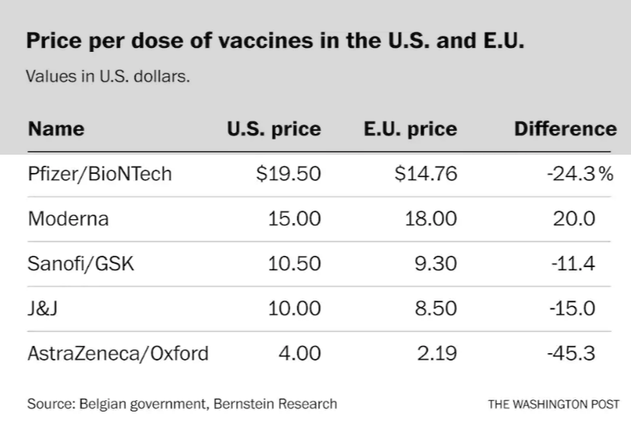
Inter-clause adjustments Ex., COVID vaccines (Jan. 21)
“The EU ... pushed the price a lot in the negotiations with AstraZeneca but, however, did not set specific deadlines for receiving the vials” (Libertad Digital)
“Even after a contract has been concluded with the EU, the manufacturers still have an interest in marketing their vaccines on the world market in the best possible way” (European Commission)
Europe was paying less than USA for many coronavirus vaccines (Washington Post)

Slide 22
b) What are the parties’ goals?
The question is ambiguous : when?
Key: their goals change, because
ex ante, focus on efficiency if parties are rational
efficiency = optimizing “the pie”
ex post, focus on distribution (if final move)
distribution = getting “a bigger share of the pie”

Slide 23
Example of a change in parties’ goals: inflation in residential rent
Imagine renting a house after zero inflation for decades → Ex ante, do not feel any need to contract for inflation adjustment
Ex post, unexpected inflation → conflict
lessor wants adjusting rent for inflation
lessee wants to keep paying nominal rent

Slide 24
3. Private ordering: Cases

Slide 25
A map of contractual solutions with examples
 | Private ordering (parties) | Public ordering (3rd parties)
Ex ante (contracting) | Explicit contracts Standard-form contracts | Law & Legislation Default & mandatory rules
Ex post (defining trade & performance) | Relational contracts E.g., labor, corporation | Courts Counterfactual hypothesis

Slide 26
Standard-form contracts (condiciones generales) written by the big party
Tradeoff: partiality vs. specialization—e.g., knowhow
Role of competition
Even for “non-salient” clauses? Over time?
Does it improve with regulation? At what cost?
Will a monopolist draft inefficient clauses?
Not if he can extract rents otherwise (remember α)
Yes if need to increase its control over pricing:
imagine buyers willing to pay higher price prefer strong warranty → monopolist may offer 2 contracts with high (low) price and strong (weak) warranty (“tie in”)
What about uniform clauses in an industry?
Is it driven by collusion or by identical circumstances and price competition in selling the optimal product?

Slide 27
Competition helps

Slide 28
Can you spot the small print?

Slide 29
A map of contractual solutions with examples
 | Private ordering (parties) | Public ordering (3rd parties)
Ex ante (contracting) | Explicit contracts Standard-form contracts | Law & Legislation Default & mandatory rules
Ex post (defining trade & performance) | Relational contracts E.g., labor, corporation | Courts Counterfactual hypothesis

Slide 30
4. Public ordering: Law & legislation

Slide 31
A map of contractual solutions with examples
 | Private ordering (parties) | Public ordering (3rd parties)
Ex ante (contracting) | Explicit contracts Standard-form contracts | Law & Legislation Default & mandatory rules
Ex post (defining trade & performance) | Relational contracts E.g., labor, corporation | Courts Counterfactual hypothesis

Slide 32
Three key distinctions
Law vs. legislation
Default vs. mandatory rules
Effects of rule changes on present vs. future contracts

Slide 33
1. The different logics of Law & Legislation
Law: ‘Market’ logic (relatively decentralized)
Trade → conflicts → judicial decisions → Evolution of customary law
Comments
e.g., merchant law, common law
evolutionary design constrained by path dependency
Legislation: Political logic (centralized)
Legislative process →
Codified customary law, primarily with default rules, may get rid of path dependency
Mandatory rules may tackle market failure
But “rational” design constrained by political failure

Slide 34
2. Essential to distinguish default from mandatory rules
Default rules
Reduce transaction costs. E.g., marital property:
AR, BI, CAT: “separation of property” by default
Others: closer to “community of property” by default
But possible to contract out via prenuptial agreements
Greater role b/c of status quo bias? Signaling?
Mandatory rules
From a normative point of view (“what should be”), contain market failures (rationality & externalities)
From a positive point of view (“what is”), often an avenue for rent-seeking

Slide 35
Ex.: Catalonia & food waste El País, March 3, 2020
“Catalonia will force restaurants to give containers to customers to take away the remains of their food”
“Supermarkets will have an area with products about to expire, according to the new law”
Questions
Is zero the optimal amount of waste?
Should the law on containers be mandatory?
Should they be given for free? Who should decide?

Slide 36
3. Effects of rule changes on present vs. future contracts
Rules: prospective (future) vs. retroactive (past)
Retroactive → different effects:
Distribution in existing contracts → Justice?
Ex.: widow w. 11 children who cannot pay the rent
(In)efficiency in future contracts → Justice?
Ex.: future leases are made impossible
Similar issue and effects for judicial rulings and legislative changes
Legal & judicial under-enforcement: A paradoxical & hard question about justice

Slide 37
5. Public ordering: Judiciary

Slide 38
A map of contractual solutions with examples
Worst information, better incentives?
 | Private ordering (parties) | Public ordering (3rd parties)
Ex ante (contracting) | Explicit contracts Standard-form contracts | Law & Legislation Default & mandatory rules
Ex post (defining trade & performance) | Relational contracts E.g., labor, corporation | Courts Ideal: Counterfactual hypothesis Failures: cognitive biases, agency, underenforcement, external (systemic) effects?
Better information, worst incentives?

Slide 39
Judges: solution... & problem
How do parties want the judge to decide?
In the rental example:
Optimal risk allocation → some inflation adjustment?
Counterfactual hypothesis: ex ante, parties want judges to decide efficiently ex post
Even if, ex post, each party wants for the judge simply to decide… in her favor
Judges’ difficulties: uninformed + agents → solutions?
Cognitive: e.g., hindsight bias (next slide), steps of reasoning
Self interested agents: corruption, fame, self morality, etc.
Externalities: case-based decision vs. systemic effects
Judicial “populism” after the Great Recession
Notes:
39

Slide 40
Ex. 1: Hindsight bias may lead judge to see an (ex ante) balanced transaction as unbalanced ex post
Ex ante, probabilities of interest rate going Up or Down = 0.5. But ex post it looks “obvious” that interest rates were going to be low
(6, 0)
Up
Fair deal: (3, 3)
Down
(0, 6) but ex post, with hindsight, probability of “Down” seems > 0.5, e.g. 0.8 → Deal seems unbalanced: e.g., (1, 5)

Slide 41
E.g., variable interest rate in mortgage loans: r = Euribor + spread
Interest rate “ceiling”
Interest rate “floor”
Contract date
Judicial decision

Slide 42
Ex. 2. Do they want rents to be capped? How will they inform themselves and vote?
Owners
Renting now a house
Thinking about renting in the future
Tenants
renting a house now
Prospective tenant planning to rent in two years
Similar questions about
Tenant with children given special protection against eviction (desahucio) in case of rent default (i.e., not paying the rent)
Why to except big landowners (grandes tenedores)?
Etc.

Slide 43
Ex. 2bis. Underenforcement (similar to retroactive change in rules)
Freezing residential rents
Retroactive (affecting previous contracts)? → underenforcement
Short term effects? Through which contracts?
Long term effects? Through which contracts?
Mandatory improvements in salaries, job conditions, etc.
Benefit for current permanent workers
Loss for future jobless workers
Rule freeing a debtor (mortgagee) from the remaining debt when giving up the property (dación en pago)
Default or mandatory? Which default rule should be chosen?
If mandatory, retroactive or prospective?
Effects of mandatory retroactive rule on existing (redistribution) and future debtors ([in]efficiency) → quality-quantity tradeoff
Response to raise in interest rates since 2022

Slide 44
Ex. 3. Tradeoff quantity- quality in judicial decisions
The Spanish case
judicial delay
More resources?
Judicial fees?
Notes:
44

Slide 45
How to be a good judge Advice from Don Quixote to Sancho (a)
“Try to find the truth in the rich man’s promises and gifts, and also in the poor man’s sobs and complaints”
(“Procura descubrir la verdad por entre las promesas y dádivas del rico, como por entre los sollozos e importunidades del pobre”)
Notes:
45

Slide 46
Advices from Don Quixote to Sancho (b):
“Never follow the ‘law of fit’. It is usually followed by the ignorant who think they are sharp”
(“Nunca te guíes por la ley del encaje, que suele tener mucha cabida con los ignorantes que presumen de agudos”)
Law of fit: a decision taken by a judge based on whatever takes his fancy, without recourse to legal provisions
Ley del encaje: “la resolución que el juez toma por lo que a él se le ha encajado en la cabeza, sin tener atención a lo que las leyes disponen” (Covarrubias)
Notes:
46

Slide 47
6. The interaction bwn private and public ordering
courts necessary to protect reputation (Tous case)
courts often interfere (inefficiently?) with reputation (Ryanair?, car dealers?)

Slide 48
Ex. #1. Tous: reputational blackmail
“Tous denounced for fraud by proving the absence of metallic filling in her jewelry,” Jan. 20, 2020.
“Tous denunciada por fraude al acreditar la ausencia de relleno metálico en sus joyas”
“The judge and the prosecutor turn the ‘Tous case’: the ‘deceptive manipulation’ was that of the complainant,” Feb. 24, 2020.
“El juez y el fiscal dan la vuelta al ‘caso Tous’: la ‘manipulación engañosa’ fue la del denunciante”
Is reputation potentially weak? Why?
How should judges, journalists, consumers react?

Slide 49
Ex. #2. “Court rules Ryanair cannot charge 40€ for printing a boarding card”
Which type of rule is this?
Was the charge contracted ex ante?
Consequences? For whom? (i.e., which customers?)
What are the relevant assumptions?
Competition—price discrimination?
Types and homogeneity of customers
Others? Treatment when printed in airport kiosks
What are the effects on prices?
Should courts allow parties to handle the contract relationally?
Meaning that the second party rules but it is punished by reputation
Are incentives aligned?
Similar case
Who do clients want to rule on purchases’ returns at Corte Inglés, judges or Corte Inglés?
Ikea? How does it affect returns policies on carpets, party dresses, return waiting lines, etc.?

Slide 50
Ex. #3. Car dealers’ networks Arruñada, Garicano & Vázquez’01,’05; Zanarone’13
Main problems of a franchise network
Vertical conflict
Horizontal conflict
Solutions: 2nd vs 3rd-party enforcement
Partiality → repetition, reputation, competition
when is it likely to fail?
Knowledge
→

Slide 51
→ A solution based on 2nd-party enforcement
Technology
Dual production process: core & service points
Differentiation, trade-ins
Hybrid organization: quasi-integration?
Prevalence of franchising
Asymmetric allocation of decision rights to manufacturers: increasing with reputation
Non-linear price discounts
Heavily litigated & regulated but persisting

Slide 52
A harder case: The labor contract
How is it organized: Market or politics? “Corporatism”?
Taxes: amount, transparency, progressiveness
E.g., Social Security charges “paid by the Employer”—see “Who really pays social security contributions and labour taxes?”
Contract regulation
Retroactive “rights”?
Default or mandatory rules?
Individual or collective?
If collective, nationwide, province-wide or at firm level?
Content of exchange
Wages: amount? Is this relevant?
Work conditions
The meaning of “free dismissal”: ex ante bargaining for severance pay instead of fixed statutory severance pay → “termination at will”
Human capital, expropriation, “new productive model”
Enforcement: asymmetrical, impartial, judicial?

Slide 53
7. Exploring the connection between values and institutions: The case of Spain

Slide 54
Spain according to the World Justice Project’s “Rule of Law Index”, as compared to other rich countries. Why?
Same corruption level but we punish corruption less http://ow.ly/shmrv
We monitor governments less
We carefully guarantee individual rights, mainly in labor area, but hardly monitor government
We suffer a deficit in the enforcement of judicial decisions, as well as more judicial delay
Finally, our laws are less stable
Are laws promulgated without enforcing them? Why?

Slide 55
Citizens’ values: (a) Prevailing Statism
 | Spain | Avg., EU countries
1. Who should be responsible for citizens’ quality of life
State | 76% | 51%
Each person | 20% | 43%
2. State should be most responsible for:
Universal health care | 87% | 70%
Sufficient pensions | 87% | 67%

Slide 56
(b) Distributive taxes & fiscal myopia
 | España | UE (4-8)
3. Personal earnings should be:
more balanced even if earnings of the less and more educated are similar | 49% | 29%
different to pay more to the better educated | 43% | 64%
4. Better if taxes are:
high to reduce inequality | 43% | 40%
low even if they do not reduce inequality | 40% | 43%
5. Cutting public expenditure to balance the budget preferred to increasing it to stimulate growth | 21% | 43%
6. In favor of raising taxes (from 0, in disagreement; to 10, in agreement):
- to those earning more with their investment | 7.7 | 6.9
- to those earning more with their labor | 7.1 | 4.7
- on consumption, VAT | 1.2 | 2.3

Slide 57
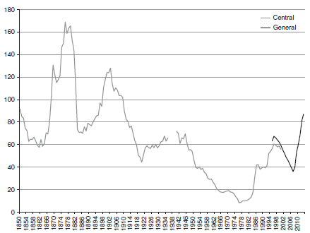
Public debt / GDP (1850-20xx) Source: Comín, “Default...”, RHE, 2012
108% in 2023

Slide 58
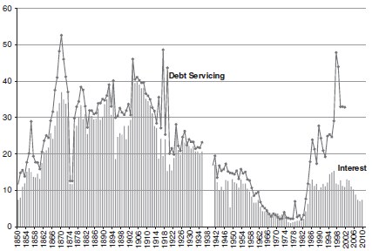
Debt service / public expenditure (1850-2013) Source: Comín, “Default...”, RHE, 2012

Slide 59
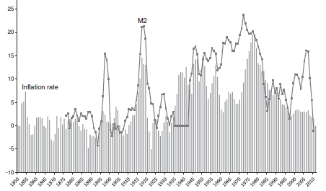
Inflation (1850-2013) Source: Comín, “Default...”, RHE, 2012
+5,7%
2022

Slide 60
“Fiscal irresponsibility” (Comín) Fiscal self-deception?
 |  | Spain | UE-15 | UE-4
Public expenditure / GDP (2015) |  | 43.3% | 47.9% | 48.6%
Public revenues / GDP / PIB (2015) |  | 38.2% | 45.5% | 46.1%
Difference |  | -5.1% | -2.4% | -2.4%
IRPF | Collection in % GDP, 2015 | 7.5% | 10.0% | 9.4%
 | Marginal tax rate IPRF, 60k€, 2015 | 46.0% |  | 40.5%
 | Implicit tax rate on labor income | 32.2% | 39.1% | 37.1%
VAT | Collections in % GDP, 2015 | 6.5% | 6.9% | 6.4%
 | General rate, 2016 | 21.0% |  | 20.3%
 | Implicit tax rate on consumption, 2014 | 15.2% | 19.8%* | 19.2%
Fees | Total in % GDP, 2015 | 2.2% | 3.1% | 3.2%
Source: Conde-Ruiz et al., 2017.

Slide 61
(c) Interventionism
 | España | UE (4-8)
7. State should be most responsible for:
Controlling prices | 60% | 40%
Controlling salaries | 57% | 32%
Controlling firms’ profits | 49% | 32%
8. In favor of (from 0, disagreement; to 10, agreement):
- Regulate banks more | 8.5 | 7.8
- Make labor market more flexible | 4.9 | 6.2

Slide 62
Inconsistent preferences Source: Special Eurobarometer 529

Slide 63
(d) Polítics: more leftish & ideological, less rule of law; more “pro-EU”
 | España |  | UE (4-8)
9. Where do you place yourself in the political spectrum (0, left; 10, right) | + leftish: | 4.4 | 5
10. What’s most important when voting for a party:
leaders’ knowledge and competence | elitism: | 9% | 17%
ideology | + ideology: | 21% | 8%
11. Respect for the law fundamental for democracy | rule of law: | 84% | 89%
12. Difference in % of people who consider being part of the EU positive and negative | + UE: | 48% | 25% (4)

Slide 64
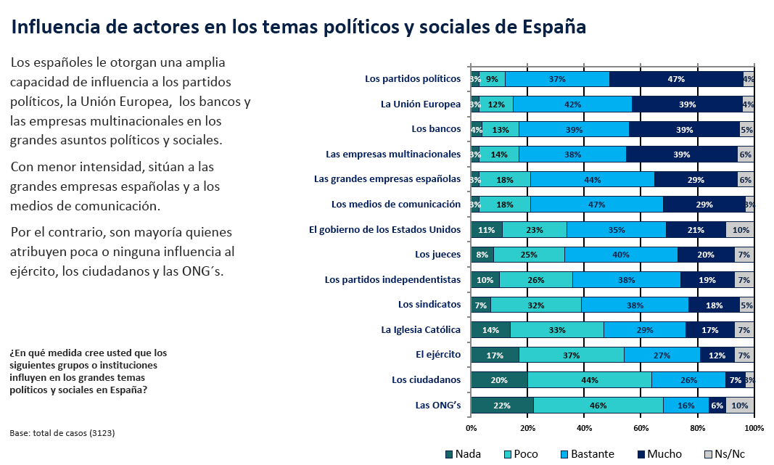
More perceived influence…
Source

Slide 65
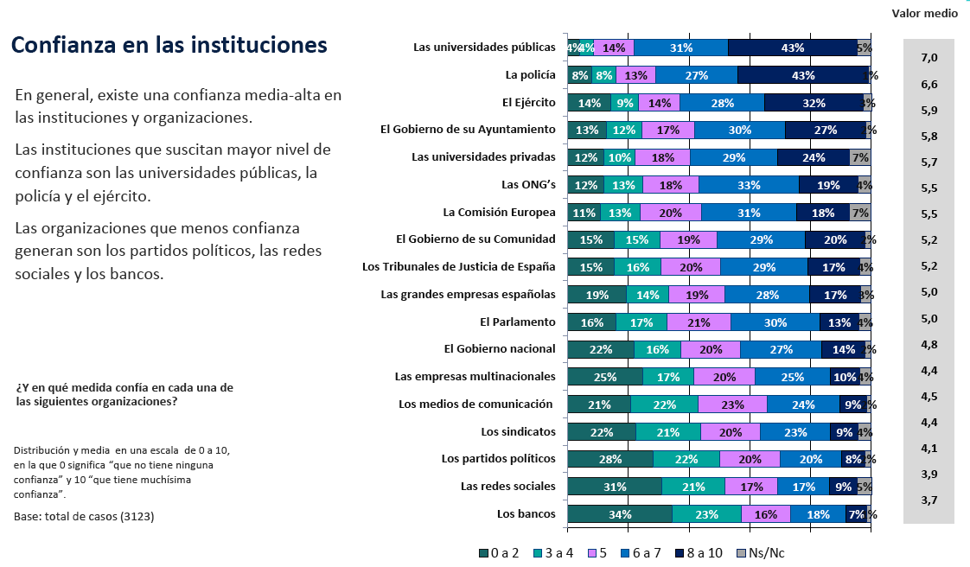
…less trust?
Source

Slide 66
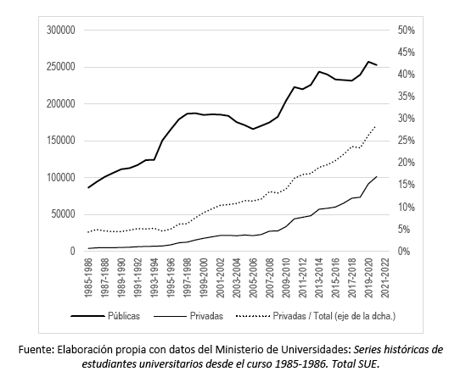
But, who knows better about universities? The graduates’ share of private universities is rising:

Slide 67
8. Bonus track: Other Applications

Slide 68
A fashionable concept: “Extractive elites”—Rationale or excuse?
Is rent extraction, opportunism in economic or social interaction rare or prevalent? E.g., shirking in agency:
Rents extraction by “the elite”?
Collective action by voters?
Is corruption more prevalent among rich or poor people?
Does it change if we think on tax evasion, benefit capture, redistribution politics?
Should we allocate responsibility for political failure to the elite or the people?
How should we think about it? I.e., whatever current allocation how to allocate it productively?
Notes:
68

Slide 69
The moral narratives of Economists Randazzo & Haidt, Econ Journal Watch, 2015, 12(1), 49-57
“Economists who believe governments should not interfere in markets to address income inequality also tended to define fairness in proportional terms (i.e., being rewarded in proportion to your contributions), rather than in terms of equality. Meanwhile, economists who did believe there should be a role for government in reducing income inequality tended to see equality as a moral imperative….
What is surprising is that we found a relationship of roughly the same magnitude between economists’ moral narratives and their empirical, technical, ‘positive’ economic theory views, too.
Economists… who tended to take Neoclassical economic theory positions also tended to show a moral judgment profile similar to what you would find amongst political conservatives in America. For example, economists that tended to favor fiscal austerity during a recession defined fairness in proportional terms and gave equal weight to reducing physical harm and preserving individual rights”.

Slide 70
“[E]conomists who took New Keynesian positions on our economic theory propositions, such as opposing austerity during a recession.. tended to have moral worldviews similar to political progressives, such as defining fairness in terms of equality and being less likely to consider today’s federal budget deficit harmful to the economy….
Finally, our survey data shows that responses to moral propositions can be used to predict responses to empirical (positive) economic theory propositions. For example, how much importance an economist assigns to the moral foundation of “care” predicts views on whether austerity is good or bad for economic growth, whether a single-payer healthcare system would reduce national healthcare costs or not, whether minimum-wage laws benefit or harm workers, and whether or not national debt and deficits adversely affect economic growth.
Collectively, this data shows that economists’ substantive conclusions about the workings of the economy are suspiciously correlated with their moral values. We cannot prove causation with our survey design, but given everything else we know about the power of motivated reasoning…, causal effects are quite likely”.

