Slide 1
Markets and Organizations
Briefing on Divisionalization

Slide 2
Outline
Link to topic 4 (Markets & Politics)
  How to implement political decisions?
    Law → topic on institutions
    Public services: 1) “make” or “buy”? And 2) If “make”, how to organize them? → this topic
I. Briefing on divisionalization
II. Bureaucracy
  Expense centers and their reform
  Reform of public services
  Learning from old public services: Modest “automatic management”

Slide 3
Part I
Markets versus firms → Divisionalization

Slide 4
When do firms beat markets?
High “transaction” costs
  tautology? (“statement that is true by virtue of its logical form alone”)
E.g., caused by “specific assets”
  Specialized & + valuable in a relationship (e.g., an isolated pipeline) → “Fundamental transformation” from competition ex ante to monopoly ex post; and
  given that contracts are “incomplete”, to avoid bargaining & hold up ex post, leading to underinvestment ex ante
  → Vertical integration—boundaries of the firm

Slide 5
When do markets beat firms?
High “Organization” Costs (internal transaction costs of both, coordination & motivation)
  for replicating the market without its “natural” incentives of prices & property rights → “artificial” organizational structure:
  Example: The impact of GPS-based systems on trucking vertical integration in the USA and EU: evaluation without compensation?
 | Allocation | Evaluation | Compensation
Market | Property rights | Automatic | Automatic
Organization | Decision rights | Artificial | Artificial

Slide 6
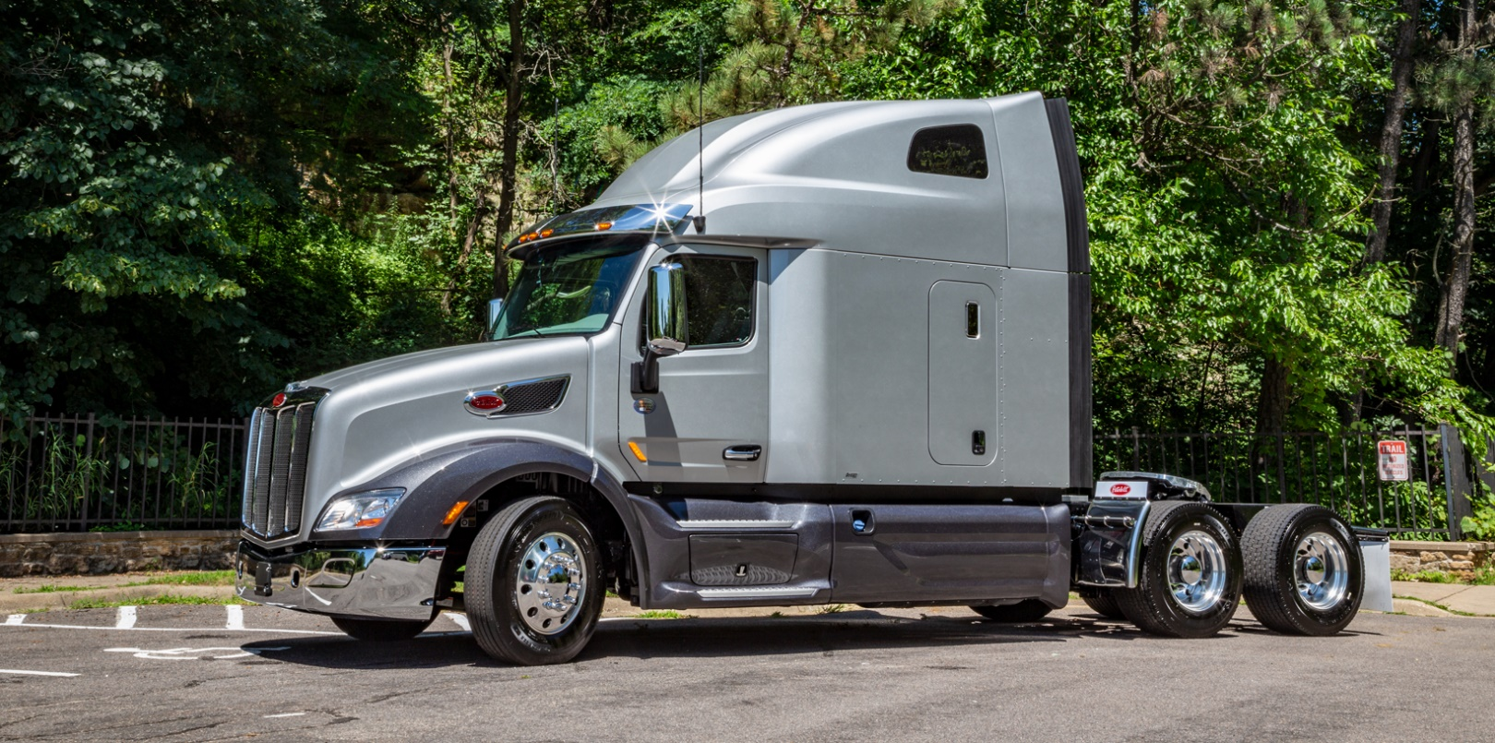
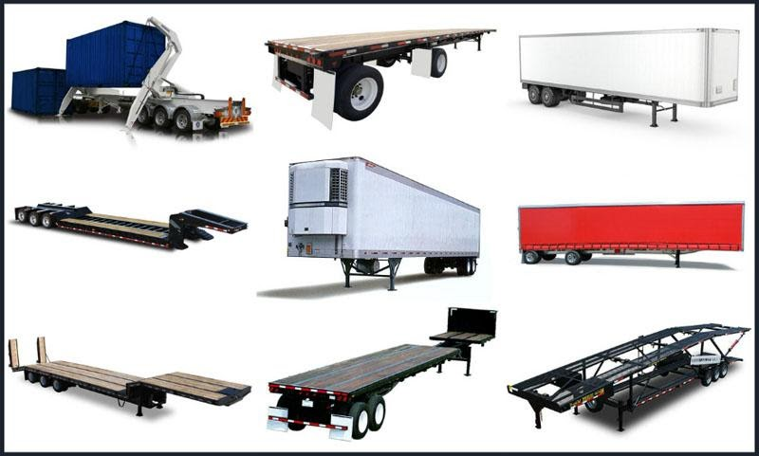

Slide 7
Divisionalization
More or less centralized solutions driven by control & information costs
  Hayek’45: importance of local, specific, information
“Selective intervention” from the center impossible b/c internal transaction costs
  Commitment (credibility)
  Agency (self interested center)
  Influence (politicking by units)

Slide 8
Divisionalization types
Decentralized units w. freedom & responsibility (“responsibility centers”)
  cost centers
  revenue centers
  profit & investment centers
  franchising
  objective evaluation of performance based on cost, etc.
Centralized solutions: expense centers (“bureaucracy”)
  subjective evaluation of performance
  our focus: incentives, failures and solutions—how to move them into responsibility centers

Slide 9
Part II(a)
Bureaucracy and Its Reform (a):
Expense centers & budgets

Slide 10
Centralization in bureaucracy
(i.e., “discretionary expense centers”)
Allocation
  Budgets—competition among units, cuts in crises
  Rules: what, how and for whom to produce– e.g., UPF
Evaluation
  Compliance with rules
  Performance
    Short term: Little and not explicit evaluation; often, none
      Marginal (módulos in courts)
    Long term: entry (oposiciones), before promotion
Compensation
  Compliance as a minimum
  Automatic: e.g., deferred compensation
  Promotion, appointments

Slide 11
Incentives in bureaucracy
Users not charged
  Taxes unrelated to consumption → No opportunity cost
Providers not incentivized
  at least not explicitly and not in the short run
    more so in the long run through selection and deferred compensation, but again not linked to performance
Budget office badly informed on
  supply: production costs
  demand: value to users
Notes:
Ex Twitter after Elon Musk

Slide 12
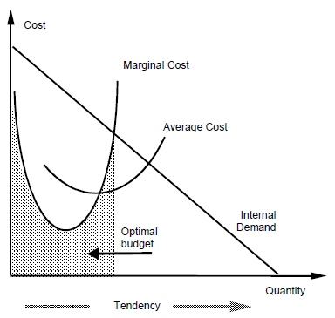
Discretionary expense center with increasing cost function

Slide 13
The equilibria of a bureaucracy: Niskanen’s model
Maximize budget for two demand functions, D1(Q) and D2(Q) subject to total utility >= budget

Slide 14
To clarify
Deferred compensation & ‘progressive’ income tax
  Progressive = tax % grows with income →
  For the same NPV (net present value) of life income, workers pay more taxes if their compensation is deferred → it discourages investment in human capital, etc.
Expense centers’ incentives:
  Zero Price paid by users →
    consumers use to demand too much
  Empire building →
    producers interested in producing too much
  But not the same for all services, given diffs. in value & info

Slide 15
Production under competition, monopoly and bureaucracy

Slide 16
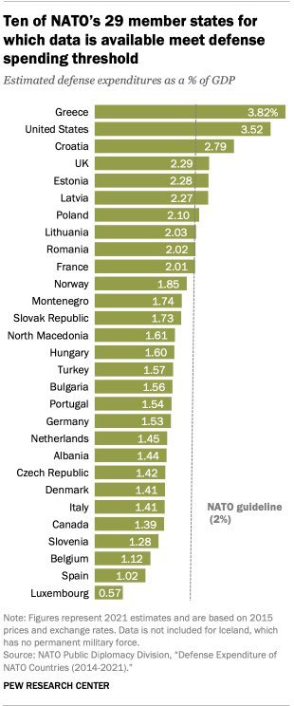
Not so simple: Counterexample

Slide 17
Social choice on public services
Market failure
  Externalities, public goods, natural monopolies
  How did they vary from XIX to XXI centuries?
    courts, police, prisons, army, foreign relations
    education, health, pensions, housing, etc., etc.
→ political intervention
  Financing and producing public services
    How to organize production? Bureaucracy
  Only financing public services
    How to contract them? Subcontracting, internal markets

Slide 18
How to organize the Royal Household?
News for Spain: recently set salaries
  Issues, more generally?
Functions? I.e., “outputs”
What about inputs?
  Accountability?
  Bought where?
Budget?
  How to set it? What to include?

Slide 19
Examples: Questions on the organization of public services
How are UPF, TV3, SCS paid and by whom?
What incentives do users & suppliers have?
What incentives do those responsible for budgeting have?
  Are they really “responsible” for the budget?
Who does finance the budget?
  What incentives do they have?
  What information do they have?
    What incentives do they have to find information?

Slide 20
Key problems of bureaucracy
Budgeting conflicts b/c information asymmetry
  Vertical: expense center “gaming” budget unit
  Horizontal: battle for resources among expense centers
Conflicts lead to too big overall, compatible with some units being too small
  Vertical conflict → Users and providers collude against budget office → too big overall (public sector?)
  Horizontal conflict → Bad allocation among centers →
    too big units (universities?, curative medicine?)
    too small units (kindergarten?, preventive medicine?)
      ‘Too big/small’ = bigger/smaller than perfect-information, the size that perfectly informed individuals would ‘truly-prefer’

Slide 21
Common budgetary practices
Too big → Cyclical recidivism
  Overspending → Cutbacks → Overspending...
Budget competition between units
  b/c of information asymmetry, which is “easier” to cut back? E.g.:
    Schoolteachers or bus drivers’ wages?
    Preventive medicine or cardiology?
Annual “incremental” budgeting
  Outdated → “Zero-based” Budgeting → Outdated...
Some real cases →
Notes:
Overheads are the expenditure which cannot be conveniently traced to or identified with any particular cost unit.

Slide 22
Ex. 1. Death while waiting
According to “the head of the heart surgery unit at the Hospital de Sant Pau, 7 patients died while waiting for surgery”
Which are the explicit and implicit prices?
Were they playing a strategic game?
Consequences?
Applicable to conduct by governments?
  Local, regional and/or national?
Notes:
(El País, June 7, 2000)

Slide 23
Los 35 muertos (El País, 7 de junio, 2000).
Desde que, el pasado 18 de mayo, el jefe del servicio de cirugía cardiaca del hospital de Sant Pau de Barcelona, Alejandro Arís, hiciera público que siete pacientes habían fallecido mientras esperaban a ser intervenidos en ese centro, un goteo continuo de denuncias ha incrementado hasta 35 la lista de muertos en similares circunstancias en España.
El Hospital Sant Pau asegura que la mayoría de los nueve fallecidos no estaban en lista de espera (La Vanguardia, 25 de mayo de 2000)
La investigación impulsada por el Hospital de Sant Pau en relación con las muertes de nueve pacientes que, según el jefe del Servicio de Cirugía Cardíaca, Alejandro Aris, fallecieron al estar en lista de espera para una intervención, concluye que seis de ellos ni siquiera se encontraban en la lista, y que ninguno de ellos murió como consecuencia de encontrarse en esta situación. Sanitat atribuye a la fatalidad las muertes en listas de espera
Planes de choque tras el escándalo (El País, 7 de junio, 2000).
Dos semanas después de las primeras denuncias por fallecimientos en lista de espera (18 de mayo), las administraciones empezaron a hacer públicos planes de choque.... Éstas son las cuatro propuestas más señaladas realizadas hasta la fecha.
Insalud. El presidente del Gobierno, José María Aznar, anunció... la ampliación de la actividad quirúrgica de los 13 hospitales del Insalud con servicio de cirugía cardiaca...
Cataluña. La Generalitat de Cataluña anunció el lunes pasado que va a destinar 3.000 millones de pesetas en impulsar un plan de choque que reduzca los tiempos de espera...
UGT insta a los enfermos a que denuncien su situación (El Mundo, 24 de mayo de 2000)
El sindicato UGT instó ayer a los enfermos que llevan «un tiempo injustificable» en listas de espera a denunciar su situación ante la Consellería de Sanitat o, si cabe, ante los juzgados...

Slide 24
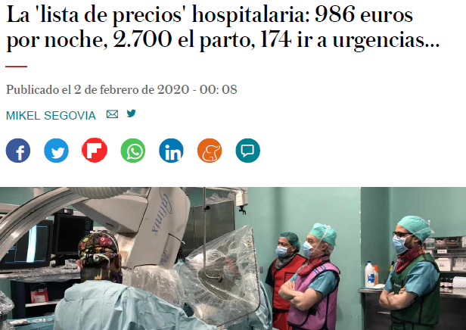
Ex. 2. How much does a night in hospital cost? Urgent Care?
Note that this type of estimates vary a lot (see this link)—why?

Slide 25
Ex. 3. Budget cuts after 2008 crisis
Discussion questions
After the economic crisis starting in 2007, were public services substantially reduced?
Were wages cut more in the private or in the public sector? Why?
What about jobs? Why?

Slide 26
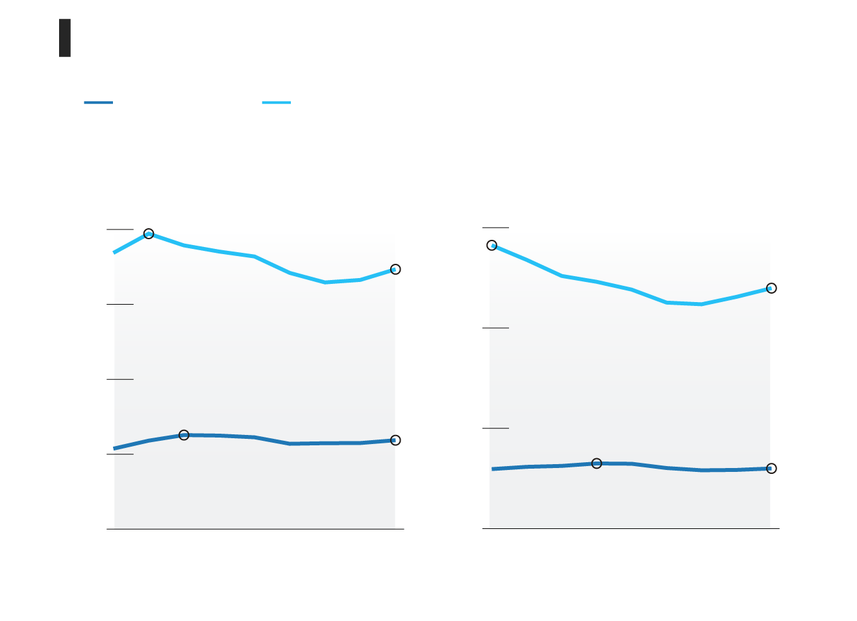
Budget cuts in Spain, 2007-15
Employment (private and public) before (2007) and after (2015) the econ. crisis, in Spain. Salaries (left) and jobs (right)
Salaries
Jobs
SOURCE: http://www.elmundo.es/economia/2016/04/25/571cf47f468aeb88178b4679.html

Slide 27
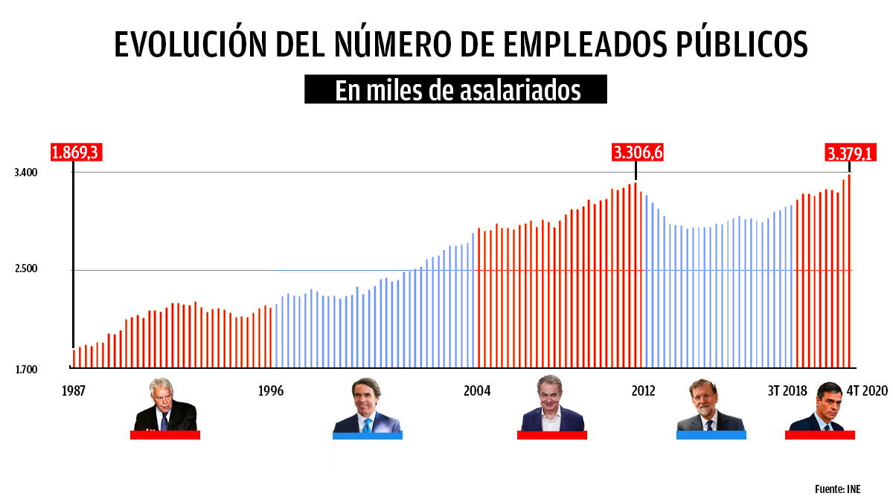
Number of public-sector employees in Spain
(thousands)

Slide 28
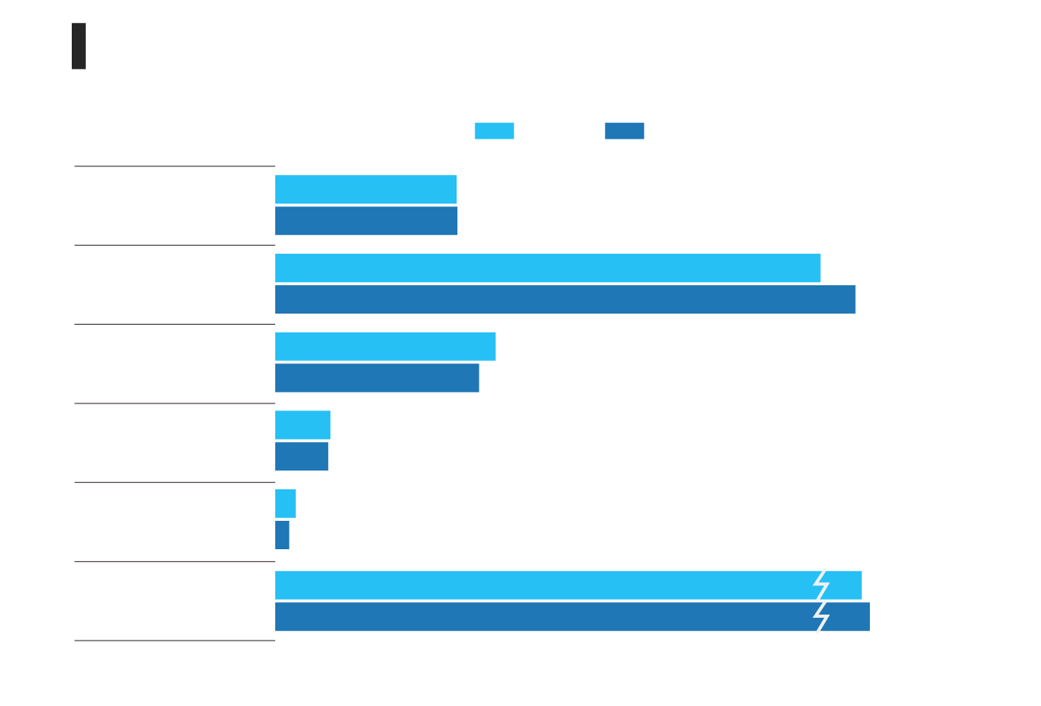
Budget cuts in Spain (2):
Public jobs before (2007) and after (2015) financial crisis
Central Government
Regional Governments
Municipal Governments
Total
SOURCE: http://www.elmundo.es/economia/2016/04/25/571cf47f468aeb88178b4679.html

Slide 29
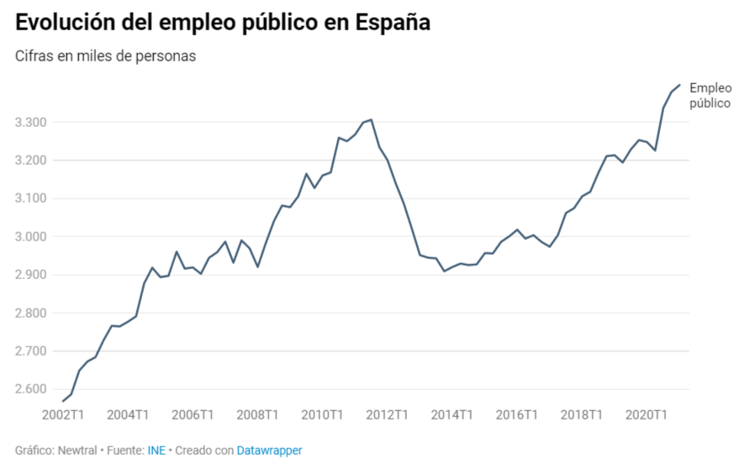
Public sector jobs in Spain (000s)

Slide 30
Ex. 4. ‘Starving the beast’ argument
Big-name Friedman, Becker, Lazear, Murphy
  Cut taxes → deficit → automatic control of public expenditure
Niskanen
  Lower taxes perceived as lower “price” of public services
  More debt
How does it work in… CAT? …Spain? …EU?
Notes:
(El País, June 7, 2000)

Slide 31
Ex. 5. Cost ‘allocation’. Is it effective?
Joint costs imputed according to cost “drivers”
  E.g., heating costs allocated proportionally to surface
  Allocation of overhead based on direct labor
Effects like prices:
  Possible cost consciousness (Zimmerman)?
  Distortions: e.g., surface → excessive height; direct labor → excessive capital intensity; like taxing windows & narrow dark houses…
“Activity Based Costing” (ABC) =
  Choosing the “right” drivers (easy to say!) and minimize product variety

Slide 32
Part II(b)
Bureaucracy and Its Reform (b):
Internal Markets

Slide 33
Radical solution: modify the incentives
Break public financing from public provision
Users
  prices or vouchers + freedom to choose
  Key: opportunity cost thru freedom of choice (among expenses, internal or even external providers, etc.) = “implicit” prices
Providers
  freedom to organize provision, and
  pay for performance (linked to demand), even profit sharing
Objective: better resource allocation
  Users reveal their information on value of service and providers
  Providers organize + efficiently (reveal info on cost)
  → Users’ demand guides providers’ supply → “internal market”

Slide 34
But note how real & artificial (“internal”) markets work
 | Allocation | Evaluation | Compensation
Market | Property rights | Automatic | Automatic
Organization | Decision rights | Artificial | Artificial
Real markets rely on property rights, which automatically
  Evaluate performance
  Reward owners
  Reallocate resources
In artificial markets, a bureaucracy must perform the same tasks →

Slide 35
Budget office becomes a market planner
Designs the market
  Allocate decision rights
  Design and implement evaluation systems
  Reward decision makers who are not owners (agency)
  How strong? (E.g., “profit”? Need to match w. decision rights)
Avoids market failure
  Information & externalities: Worst than in real markets?
  “Locus of uncertainty” problem—how serious? → next
Tolerates market decisions
  The stronger the incentives the more likely the failures and the harder to tolerate market decisions
    If we are reluctant to close private firms (Air Europa), will we accept the market’s verdict on public services?
    Imagine closing schools, health units, hospitals, univs.

Slide 36
Jensen & Meckling’s “locus of uncertainty” problem
Matching supply and demand to avoid parties’ freedom causing surplus capacity
Factors:
  Expense composition affects consumption predictability
  Computers help real time budgeting
  Capacity to speedy re-contracting of recourses
  Flexibility for internal reallocation of recourses

Slide 37
Tolerating market decisions
Are internal markets applicable to...
  ... public healthcare? NHS? Shadow invoicing?
    Health services for Spanish civil servants: How organized? Lessons?
  ... primary and secondary education? School subsidies?
  ... the university system?
    Imagine possibilities
    Consequences
    Expected problems
But is there any point in creating an “internal market” if it will only be “disobeyed”?
  Example: What changes and decisions has the current system of chartered schools (conciertos) led to? Next →

Slide 38
Example: Chartered schools
(“concertadas”)
Basis for internal market in place: private and public schools, money following users
When demography down, demand switched towards chartered schools
Modest variability in 17 regions: Most of them:
  Constrained users’ choice
  Constrained chartered schools’
    Organization: uniform salaries, co-education, etc.
    Size, blocking growth
  Chartered schools dropped to public standards?

Slide 39


Slide 40


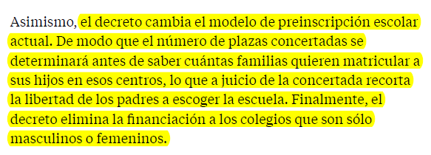
“La normativa que prepara Educación y que previsiblemente se tramitará por la vía de urgencia supone que la administración pase a programar toda la oferta de plazas escolares, incluidas las concertadas, antes de saber cuántas familias harán la preinscripción.” (LVA, Feb. 10, 2020)

Slide 41
Next: Modest “automatic management” applying some market elements. Examples:
How are the following organized in Spain?
  ... Notaries?
  ... Property and mercantile registers?
How were the following organized up to the 1980s...
  ... courts?
  ... Primary health centers?
What are the characteristics of these solutions?
  Powerful incentives?
  Civil servants or employees?
  Degree of regulation?
  Effectiveness > efficiency?
What about transplants of human organs?
  See, e.g., “Manufacturing Success” by Costas & Lozano

Slide 42
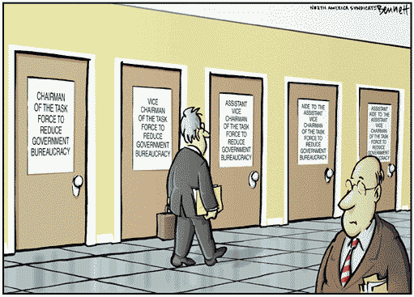

Slide 43
Paradox
Transition into decentralized “market-like” solutions (e.g., responsibility centers, even “internal markets”) poses a giant... bureaucratic problem
  High costs
    the URSS’s Gosplan had 18 million employees
    Matching demand & supply: “locus of uncertainty”
  But weak incentives
Let us see other options

Slide 44
Part II(c)
Bureaucracy and Its Reform (c): Learning modest “automatic management” from traditional public services

Slide 45
Registries as expense centers
Supply
  Standard civil service paid with fixed salary
Demand
  Cadaster: fees
  Civil registry: Most fees suppressed in 1986
Service time?

Slide 46
Notaries & land & co. registries
Supply: Regulated public franchises
(built in 1861-62 upon the sale of offices of the Ancient Regime)
  Decision rights: regulated in detail (entry, process, fees, etc)
  Evaluation and compensation:
    Closed number + entry exams → deferred compensation
    Compensation with office’ profit → “local” efficiency
      E.g., employers → top employees also share profits
    Strict liability
Demand: Users pay fees, choose notaries, not registries
  Notaries in local competition + Registrars in territorial monopoly
  → Tension → Mutual control
Vertical control similar to an appeals’ court
  Counsels (Letrados) with inspection & appeal functions
  Paid fixed salary (why?) + substantial deferred compensation (pantoufles)
Recent regulatory decisions
  Suppressed counsels
  Tried and failed to introduce free choice of registrars
  Drastically cut fees → key: understanding quasi rents
  Emphasized reducing service time (is it an important quality dimension?)
    Fees collected after registration → delay

Slide 47
Another solution:
HM Land Registry (England & Wales)
< 1990, a bureaucracy → registration took 34 weeks on avg., despite huge surplus
> 1990, a “trading fund” (somehow similar to state-owned firm)
Incentives
  Strong globally: 3.5% targeted “return on capital”
  Weak individually: small, only top managers
Partial privatization being considered—viable?

Slide 48
How did these different registries respond to…
… huge demand increases?
  EU co. directives → co. register?
  Immigration → civil register
  Real state bubble → land register
  End of real state bubble → land register
… the ups & downs of the state budget cycle?
  E.g., land vs. civil registers
… (trickier) regulators’ requests?

Slide 49
Both English and Spanish land registries comparatively “efficient”
Both are registries of rights (so called “Torrens”) → high legal quality
Compared to other EU registries:
  Lower transaction costs (x10 order-of-magnitude) and more effective (e.g., speedy foreclosure)
Compared to Spanish registries organized as expense centers:
  Cadastre takes 6 months-3 years vs. land registry 1 week
  Civil registry could not cope with immigration—land registry coped easily with both real estate bubble and bust
  Or even financial registries: +2% annual fees on capital

Slide 50
But is local efficiency conducive to systemic efficiency?
Number of registry offices
  Spain: +1000
    registrars lack decision rights on entry + c
    cross-subsidy bwn users +
    State poor incentives to close registries
  England: 17
    HMLR motivated to minimize costs
    → adds risks to privatization
Solvable by tinkering with the design without costly “management”?

Slide 51
Learning from old services: Salient features
Automatic management:
  Opposing incentives: fixed vs variable for controller / controlled
Partial but strong incentives
  Judges & Letrados: quality important →
    long term careers +
    deferred compensation
  Judicial clerks: pushing papers → variable compensation
  Notaries: Franchises → cost containment
  Registrars: intermediate:
    quality & externalities important → monopoly
    Franchises → cost containment
  Notaries & Registrars: property rights → e.g., employers

Slide 52
They differ starkly from internal markets, which have:
Plenty of
  management in designing & running the system
  incentives, trying to cover many dimensions of performance, ideally measured w. profit or ROI proxies
but
  few decisions
  weak incentives
    Incomplete decision rights
    Small variable compensation as % of total
    Profits or savings not given to individuals but invested in units

Slide 53
Tentative conclusion
Better than artificial market with full planning but weak incentives, bureaucracy with a few strong incentives?
Internal markets
  Costly to implement and run
  Make little impact:
    Weak incentives, likely b/c system too complex, unmanageable?
    Market “decisions” (e.g., demand shifts) are often rejected
Options for public services
  Real markets for provision, potentially w. public financing
  Bureaucracy with a few strong incentives
    Automatic management: e.g.,
      public hospitals run by fixed salary, deferred compensation managers and doctors pay for performance
    With minimalist planning units

Slide 54
Further cases for discussion (1): Judiciary
Old system
  Users paid fees for service
  Judges were paid fixed salary → quality
  Clerks were paid salary + share of fees → speed, quantity
  Mutual control bwn judges & clerks (who often earned +)
Changes suppressed:
  Variable compensation of clerks in the 1950s
  User fees in 1986, restated later for firms (why? ok?)
Situation: endemic judicial congestion
  Small productivity bonus for judges (<600 €/yr.) →
  damaged intrinsic motivation, gaming
  Frivolous litigation, sentences’ quality disregarded →
  fewer positive externalities
  Constant claims that more resources are needed. Are they?

Slide 55
Cases for discussion (2):
Civil Registry “privatization”
Spanish public registers
  Property & Cos.: fees, profits, fast, reliable, adapted to demand
  Civil: no fees since 1986, very slow, maladapted to demand
  Cadaster, IP: fees, no profits, slow, unreliable, maladapted
Interests and positions on explicit fees & “privatization”
  Why do unions generally oppose them?
    E.g., “UGT suspects Gallardón has retaken plans to privatize the Civil Register” or Water in Alcázar de San Juan (20-2-14)
    Suggest two general explanatory hypotheses
  What about users? Do they have incentives to inform themselves? To fight?
  What about taxpayers? Do they have incentives to inform themselves? …
Are arguments applicable to court fees?

Slide 56
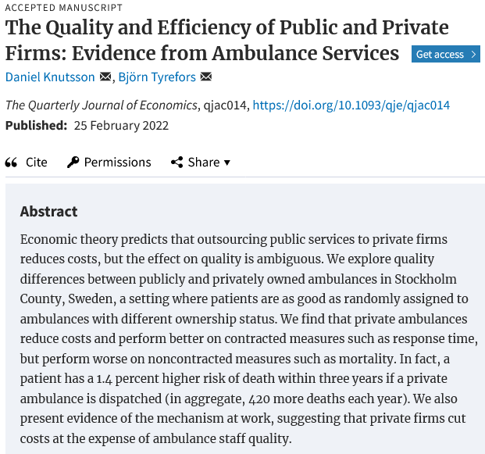
Cases for discussion (3):
Stockholm ambulances

Slide 57
Part IV
Decentralized solutions:
Managing responsibility centers
Covered in Business Economics

Slide 58
Delegation & divisionalization:
Revision
How to organize....
  ... a company with a single product and a single market?
  ... a company with several products and several markets?
  ... a university?
What do we mean by “organize”? Economic divisionalization:
  Allocation of decision-making rights
  Evaluation of performance
  Compensation

Slide 59
Types of decentralized divisions: cost, revenue, profit centers, etc.
Key: Adjusting information availability, decision rights and measured performance
Common problem: non-measured variables that need to be carefully controlled: e.g., quality in cost centers
Major issue (in profit centers): transfer pricing
  Opportunity cost: But which costs to consider as relevant depends on which decision you are making
  Common puzzles & mistakes: e.g., allocating joint costs on the basis of direct labor leads to underutilize labor
  Specific cases: decreasing costs, double margin (Problem Set)
  Interesting: field where microeconomics touches accounting

Slide 60
Effects of strong objective divisional incentives
What are the consequences of insisting that a department must...
  ... reduce costs? ... its average cost?
  ... maximize revenue?
  ... maximize its profit?
  ... maximize the return on its investment (ROI)?
How should we react to most “positive” deviations from standard performance?
  E.g., athletes, students, brokers, teachers,…

Slide 61
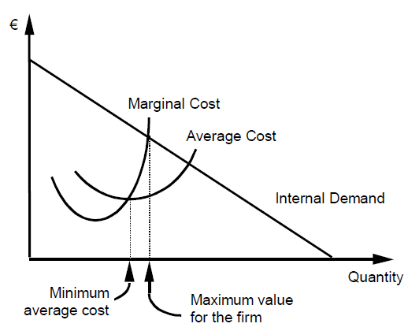
Cost center w. increasing costs

Slide 62
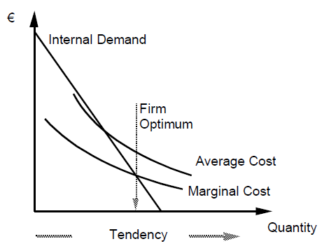
Cost center w. decreasing costs

Slide 63
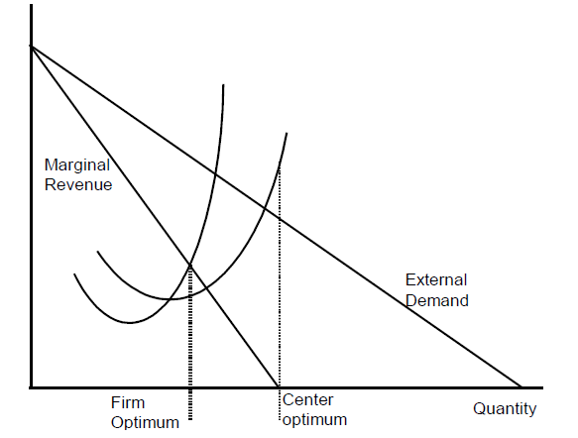
Revenue centers

Slide 64
Transfer prices
What is the optimal “transfer price”?
What problems arise in a context of decreasing costs?
  Conflict
    Congruency: MC
    Motivation: Avg FC
  Practice vs. theory
  How can this be considered in accounts?
  Should it include fixed costs?
    Fixed, annually?

Slide 65
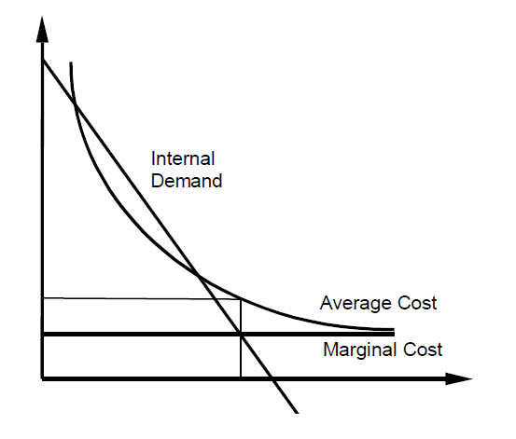
Profit center w. economies of scale

Slide 66
Case: Airport fees
“Lack of passengers advises closing down 15 airports”
How should we set the fees to use these 15 airports? On the basis of
  Marginal cost
  Total average cost
In 2012, AENA rose fees in underutilized airports such as El Prat & Barajas
  Was it sensible? Consequences?
  Whose interest is such pricing serving? AENA’s owners?
  How would you apply the transfer pricing analysis?
  Did the Ministry of Fomento do the same for the AVE?

Slide 67
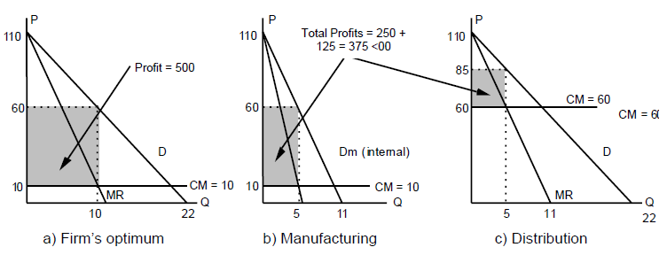
Double marginalization

Slide 68
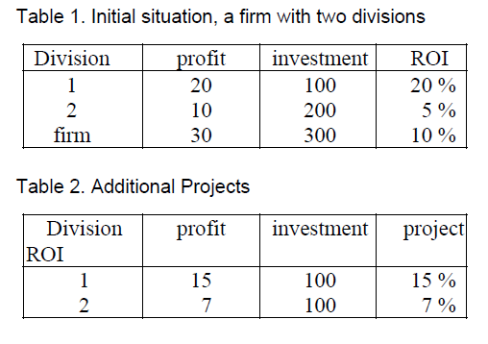
Investment center:
Ex. of investment decisions

Slide 69
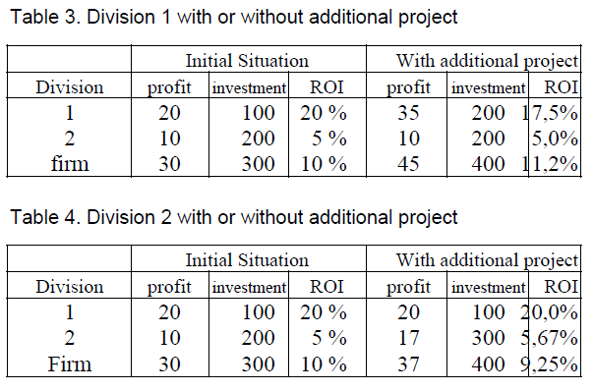
Investment center: Which decisions will be made?

Slide 70
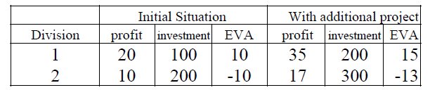
Investment centers:
Residual profit, also called
Economic Value Added, “EVA”
Assuming 10% cost of capital

Slide 71
Franchising: Initial questions
How many companies make up the +30,000 McDonald’s restaurants?
  What sort of companies are they?
What is the point of franchising?
  Think, e.g., in which sectors is it mostly found
What are the standard functions of franchisors and franchisees?
For whom does the franchisor perform a policing work?

Slide 72
Franchising: Dual technology
Constraints in the production process:
  Service industries → Dispersed demand → diseconomies of scale in provision
  Importance of local incentives
  Demand mobility → Useful to provide uniform quality
Economies of scale (in, e. g., process design, brand, advertising, etc.)

Slide 73
Franchising: Contractual Technology (Organization)
Possibilities
  Branch: a “division” organized as expense, cost, profit or investment center
  Franchising: the franchisee is paid the unit’s residual, its profit
Relational contracting:
  Asymmetric allocation of decision rights
  Self-enforcement

Slide 74
Franchising: Common clauses
Exclusivity →
  service quality, information,
Mandatory purchases →
  Quality, easier monitoring of sales
Output fees →
  price discrimination, motivation of franchisor
Example: Car dealerships
  Completion clauses
  Monitoring clauses
  Enforcement: Targets and Discounts
  Ref: Arruñada, B., L. Garicano & L. Vázquez (2001), “Contractual Allocation of Decision Rights and Incentives,” J. of Law, Econ., & Org, 17(1), 256-83.

