Slide 1
Business Implications of Evolutionary Psychology
Benito ARRUÑADA (UPF)

Slide 2
Main goals of topic 1
Learn to manage others
e.g., “Homo Administrans”, Nicholson
Improve your “toolkit” for
self-control and
social interaction

Slide 3
Outline
Organization of exchange
‘Farsighted contracting’ in TCE
Management
General management
Managing people
Marketing
Finance

Slide 4
Economic consequences (I): Organizing exchange
Assumptions in Transaction Cost Economics : bounded rationality & opportunism
Solution: “farsighted contracting”
use of calculative rationality ex ante to develop safeguards against ex post opportunism
It often collides with instinctive “contractual heuristics”—mainly, with cheater detectors
Example: Love and arranged marriages
Schizophrenic (and impossible?) palliative: do not explicitly safeguard in daily life, in marriage contract, etc.

Slide 5
Most important: Contextual contracting needed
Need to identify relational frameworks to avoid applying ‘safeguarding’ approach wrongly. Examples:
When invited for dinner, we reciprocate, we do not pay
Length of contracts differs widely
Applications
Research: more crucial to study real problems
Management: perhaps, need to distinguish explicitly:
Real management: requires instincts and, probably, self-deception to interact effectively
Business analysis: epistemological truth may help
Politics: free-marketeers need emotional message
Education: MBAs have bad fame. This may explain...

Slide 7
Example: How behavioral assumptions may affect MBAs’ salaries
Students’ quality (GMAT)
Graduates’ salaries
MBA
Placement services
Weight of behavioral as-sumptions in MBA courses
Research quality
Size of MBA core
Controls (USA, EUR, et al.)
ARRUÑADA, B., and X. H. VÁZQUEZ (2013), “The Impact of Behavioral Assumptions on Management Ability: A Test Based on the Earnings of MBA Graduates,” Management and Organization Review, 9(2), 209-32.

Slide 8
Business consequences (II): Management
General management
Managing people
Functional
Marketing
Finance

Slide 9
General consequences for management
Rationality
The rationalizing function of firms
See, e.g., slide in Beshear & Gino paper at HBR below
Specialization
Among humans: self-control
Between humans and computers
Organizational structure
“Natural” size of productive units: 100-200 individuals
Informal org. struct.: gossip & “managing by walking around”
Incentives (Topic #2)
Delicate use because, e.g.,
“Strong reciprocity” (Fehr)
“Crowding out” (Frey)

Slide 10
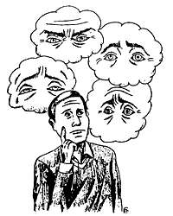
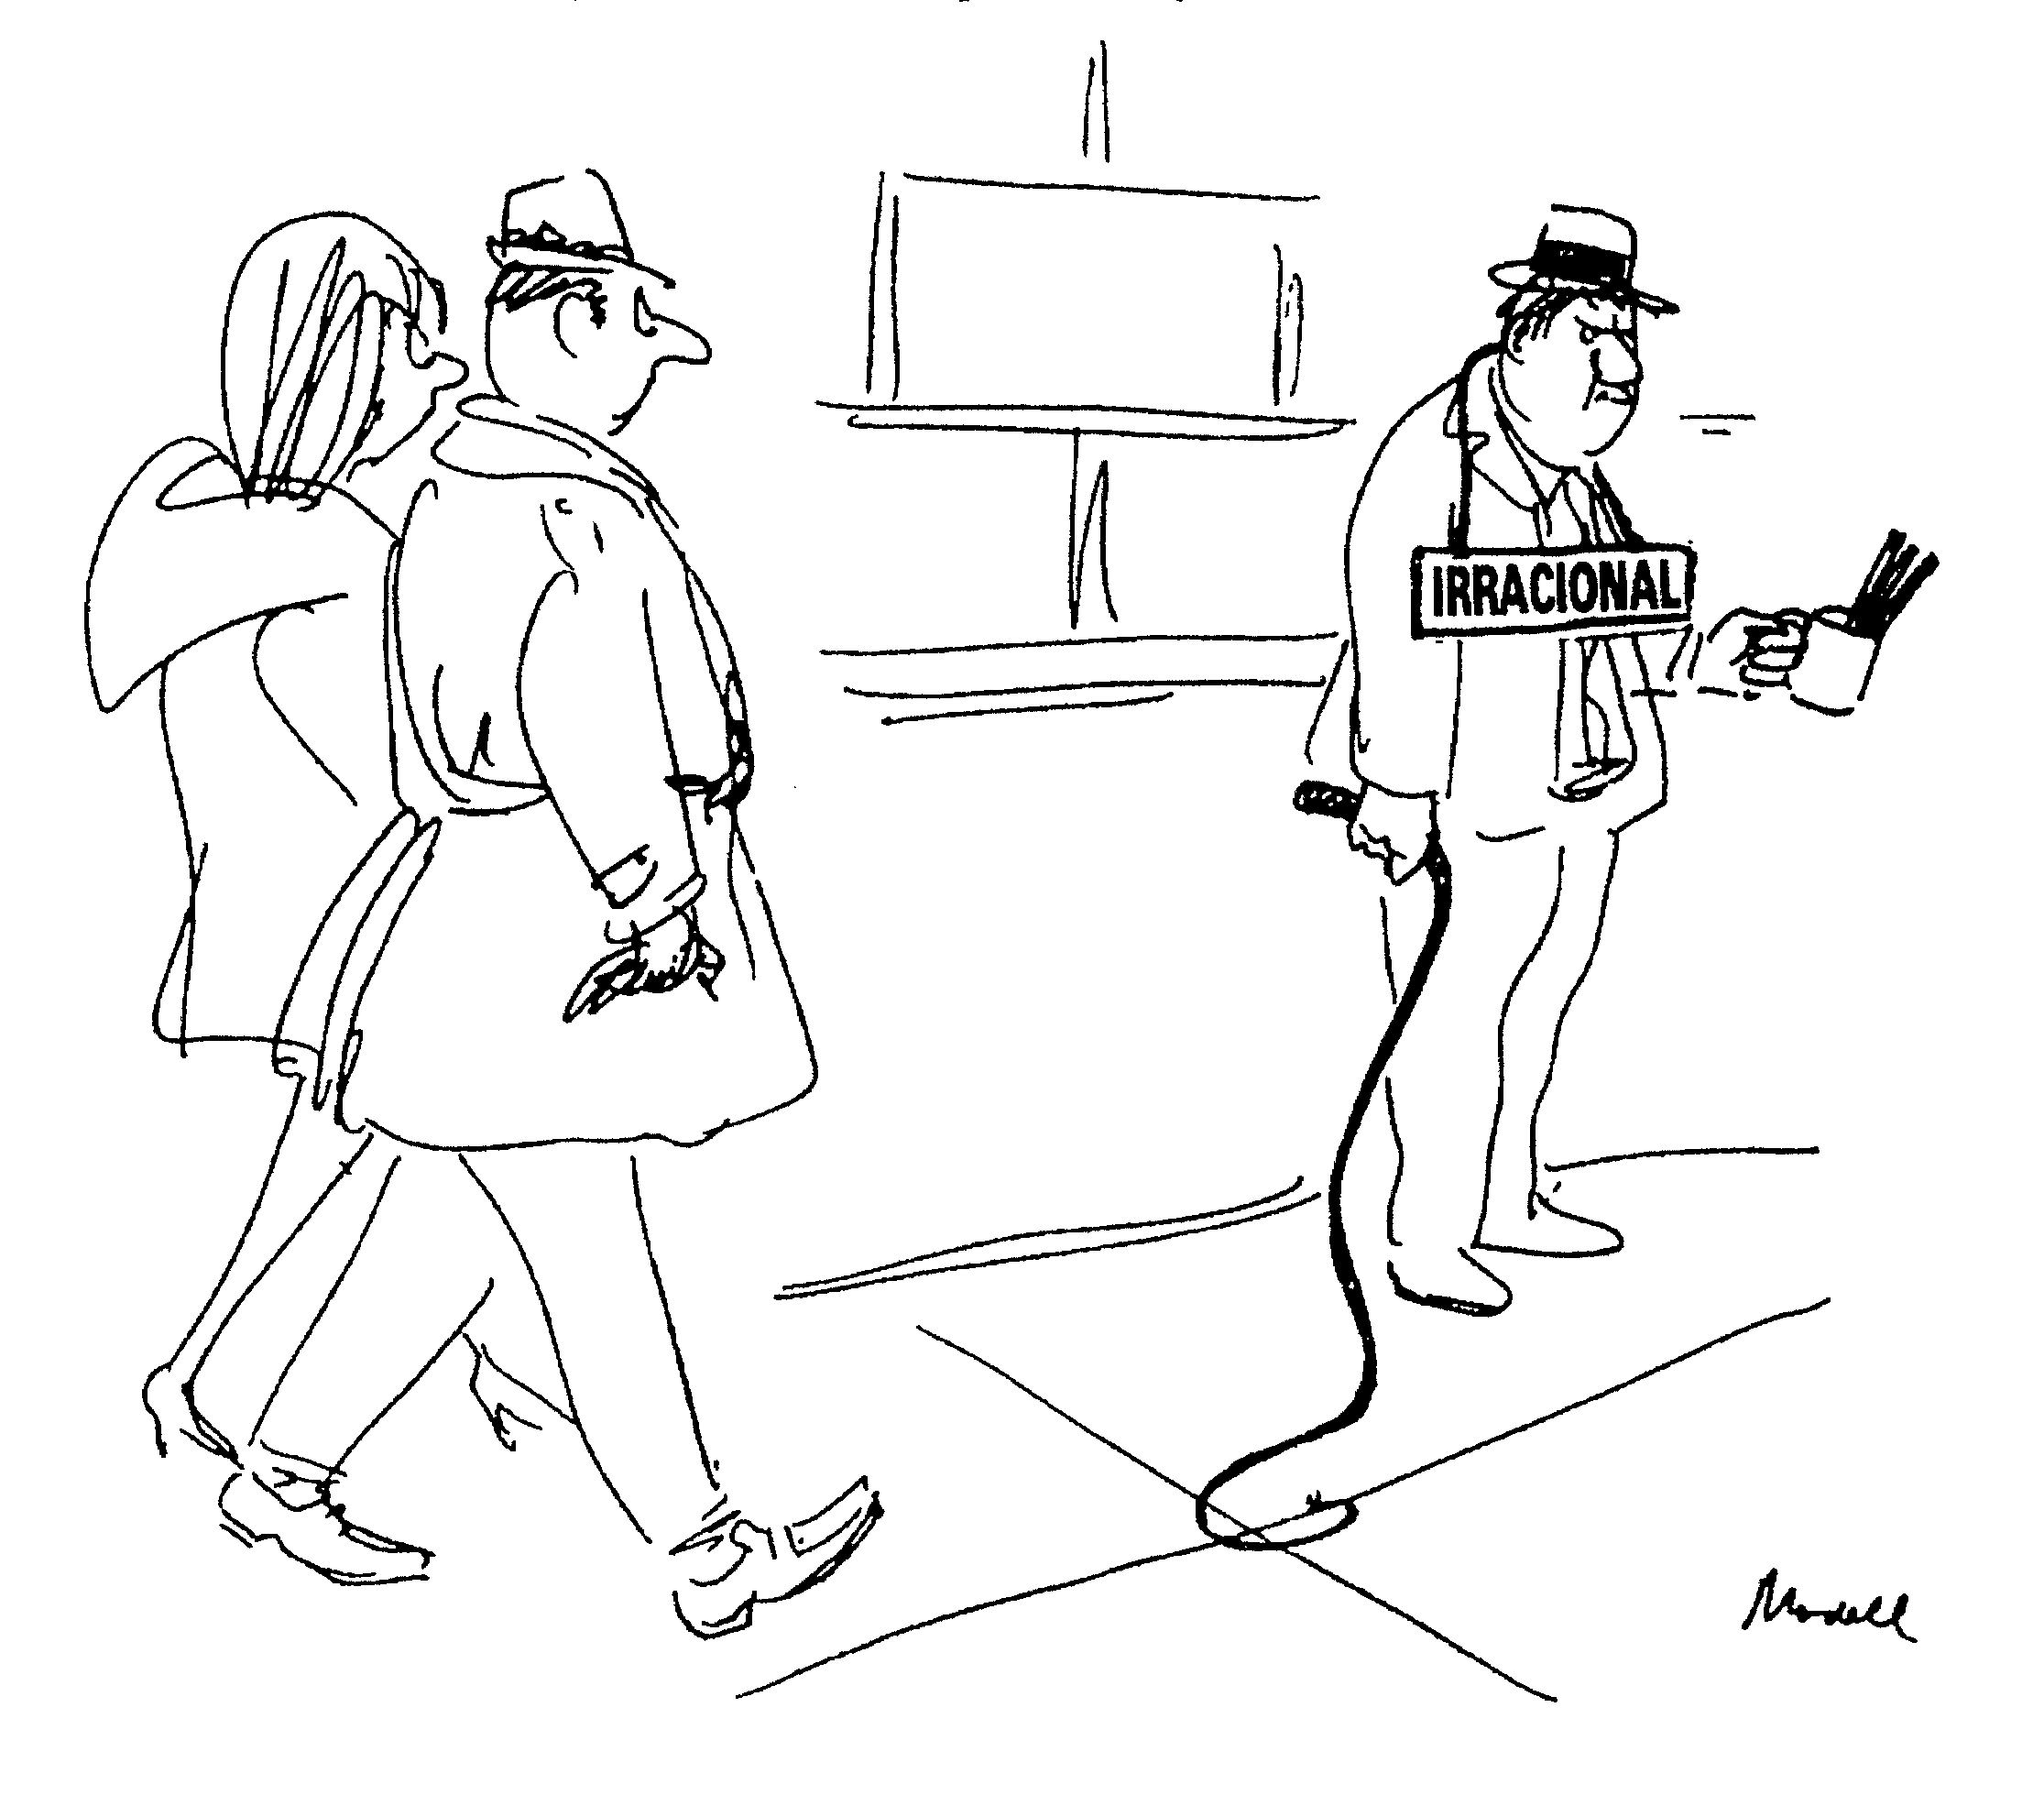
How to deal with homo sapiens? (endowed with cheating detectors, emotional commitments, etc.)

Slide 11
Consequences for managing people
“Biases”
Loss aversion → resistance to change. Change only when facing disaster
Over-optimism and overvaluation
Self-deception–necessary for leadership? At what cost? More costly when combined with herding: remedies?
Why do leaders usually feel alone? What do we ask them?
Overvaluation of status
Conformism →
Herd behavior (of leaders)
Role of rituals to consolidate groups: e.g., dancing
Detectors of human types and cheaters →
Importance of personal contact → business travel
Importance of cooperative climate for first interactions
Notes:
Map for Nicholson & The Econ’ Homo Administrans

Slide 12
Example of “simple” managerial literature: Beshear & Gino, “Leaders as Decision Architects,” HBR, 2015 (posted as a complementary reading)
How to prevent biases/mistakes: by altering the environment (“framing”) of decisions:
Understand systematic decision errors
Determine presence of behavioural issues
Pinpoint the specific underlying causes
Redesign the decision-making context to mitigate the negative impacts of biases and inadequate motivation
Rigorously test solution
Applied to, e.g., to high employee turnover, missed deadlines, poor decisions

Slide 13
“Homo Administrans” article
Contents:
Research grounded on biology (nature) effects → main lesson: selection more important than training
Emphasizes interaction nature-nurture. E.g.,:
“Genes do not operate in isolation. Environment is important,…, they interact in subtle ways”
Describes research on such interaction: Arvey: “Business-women, it seems, are born. But businessmen are made”. Also, genes less important for leadership of wealthier (more educated?) individuals
Cautions:
Limited explanatory power (2 last paragraphs)
When receiving new info perceived as contradictory or biased
Confirmatory (only nature, only nurture) → “of course”, no complaint
Conflicting (e.g., interaction nature & nurture) → complaint!!!
Do we subject nurture and nature arguments to the same standards?

Slide 14
Consequences for functional management
Finance
Possible biases:
overconfidence → too low premiums for risk
herding → speculative bubbles (real estate), pyramidal frauds (e.g., Madoff, Foro Filatélico, preferentes, etc.)
Marketing
Brand management grounded on emotions & relationships
What does Apple sell? Do customers like brands changing their logos?
Sexist advertising, no only in contents but in approach
Is advertising that addresses men sexist? … women? Examples?
Product design based on
Visual & oral symbols, no abstractions (commands vs Mac-Windows)
Pleasure without pain: e.g., artificial sweeteners
Watch this brief video clip on “The Secret Science of Advertising”

Slide 15
Is an ad with this photo addressed to women or men?

Slide 16
Notes:
“2005: Finally, Tropicana finds a market that is receptive to sexy advertising: France. ”

Slide 18
All pleasure, no consequences
“We all know we should eat more healthily, but then a craving for a bar of chocolate or a slice of carrot cake comes along and plays havoc with our will power, let alone our waistlines.
Canderel’s range of tablet dispensers and granular jars are ideal to easily replace sugar in everything, from sweetening your hot drinks to sprinkling on your morning cereals and cooking your favourite recipes. Canderel’s amazing versatility allows you to enjoy life’s little pleasures thanks to its delicious sweet taste, all for a tiny fraction of the calories that come with using sugar.”
See http://www.canderel.uk.com/static/our-range-home.html

Slide 19
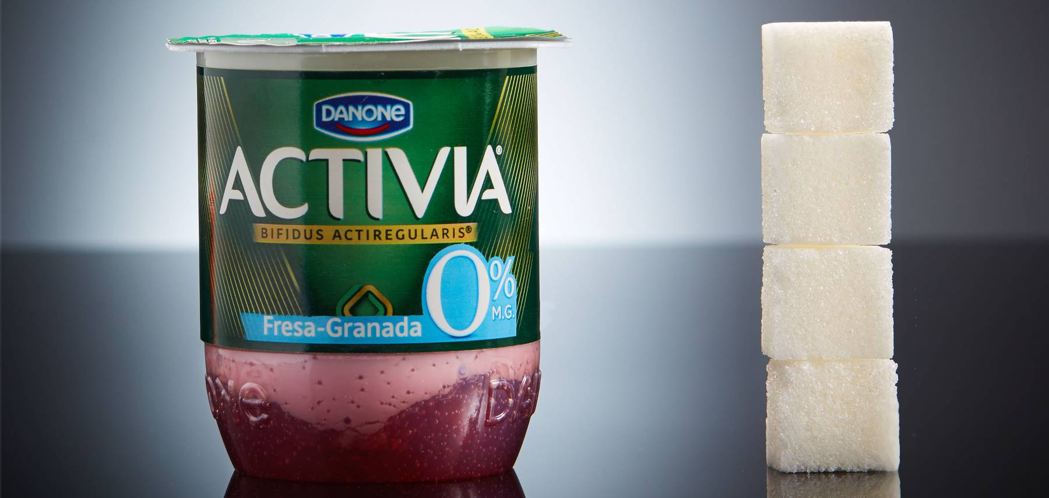
Zero what?

Slide 20
Conclusions
Narrower and better aimed use of simplifications:
Homo Economicus
“Opportunism seeking with guile”
Greater reliance on homo sapiens:
Instinctively rational and cooperative
Ecologically rational and cooperative

Slide 21
Examples of applications

Slide 22
Implicit Association Tests
You may run de test here, at Harvard’s Project Implicit,
“a non-profit organization and international collaborative network of researchers investigating implicit social cognition, or thoughts and feelings that are largely outside of conscious awareness and control”

Slide 23
Averages of a sample of self-reported scores of 306 UPF students: Slightly racist and a bit sexist (mainly males)
 | Racism | Sexism
All students | 1.16 | 0.63
Females (51%) | 1.12** | 0.41***
Males | 1.19 | 0.86
* Scales: 3, 2 and 1 respectively represent strong, moderate and slight automatic preference for white people or association between male and career; 0, little or no preference or association; with negative numbers representing preference for black people or association between female and career. * * Not significant difference with respect to male students. * * * Significant difference with respect to male students at the 99% confidence level.

Slide 24
Comments on Implicit Association Tests
Do not produce the same result over repeated trials for the same individual
But consistent results on average
Do not predict prejudicial behavior
Good news and consistent with approach: behavior not determined by nature—both nurture & individuals’ free will (& willpower?) important
See, e.g., this piece at SA

Slide 25
Unlearning implicit social biases during sleep (Science 29 May 2015)
“Although people may endorse egalitarianism and tolerance, social biases can remain operative and drive harmful actions in an unconscious manner. Here, we investigated training to reduce implicit racial and gender bias. Forty participants processed counterstereotype information paired with one sound for each type of bias. Biases were reduced immediately after training. During subsequent slow-wave sleep, one sound was unobtrusively presented to each participant, repeatedly, to reactivate one type of training. Corresponding bias reductions were fortified in comparison with the social bias not externally reactivated during sleep. This advantage remained 1 week later, the magnitude of which was associated with time in slow-wave and rapid-eye-movement sleep after training. We conclude that memory reactivation during sleep enhances counterstereotype training and that maintaining a bias reduction is sleep-dependent.”
Notes:
The Independent: “Researchers from Northwestern University in Chicago gave people "counter bias" training, which involves pairing pictures of faces with words that break down stereotypes - so women's faces were paired with words like "science" and black faces with words like "sunshine".
The subjects then had a 90-minute nap while scientists played audio cues designed to trigger the memory of the bias exercises from earlier.
The results, published in Science, found that the both after the nap and a week later, participants were less biased towards black people and women.
The results could be very useful for challenging unconscious bias in training for people in positions of authority, like judges, or people making hiring decisions.
However, the study's findings have ethical implications. The test could also work the other way, much like subliminal advertising or brainwashing.”

Slide 26
How to balance work & life?
What regrets are expressed…
by the dying?
see one of the press clippings in zip1
by many managers, both men and women?
Are they the same? Why?
How can they be remedied?

Slide 27
→ therefore, badly managed emotions threaten your career in the future; but What about… now?
How can you train yourself (“nurture”) for...
postponing gratification?
interacting better with others?
speaking in public?
keeping more control over your own career?
How should you deal now with your partner?
Making a deal, establishing “safeguards”?

Slide 28
How should UPF change?
Groups: Size? Continuity? Identity? Competition?
Exams: Necessary? How often?
Homework: Necessary? Effects?
Information on: Type of exam? Ranking in the class?
Change: Teaching method?
Others? Can you help UPF make students more rational? Meaning by rational? Improve self-control?
Do we tend to limit the changes to “UPF”—i.e., everything but ourselves?
How should OEM-EIM change?
Notes:
28

Slide 29
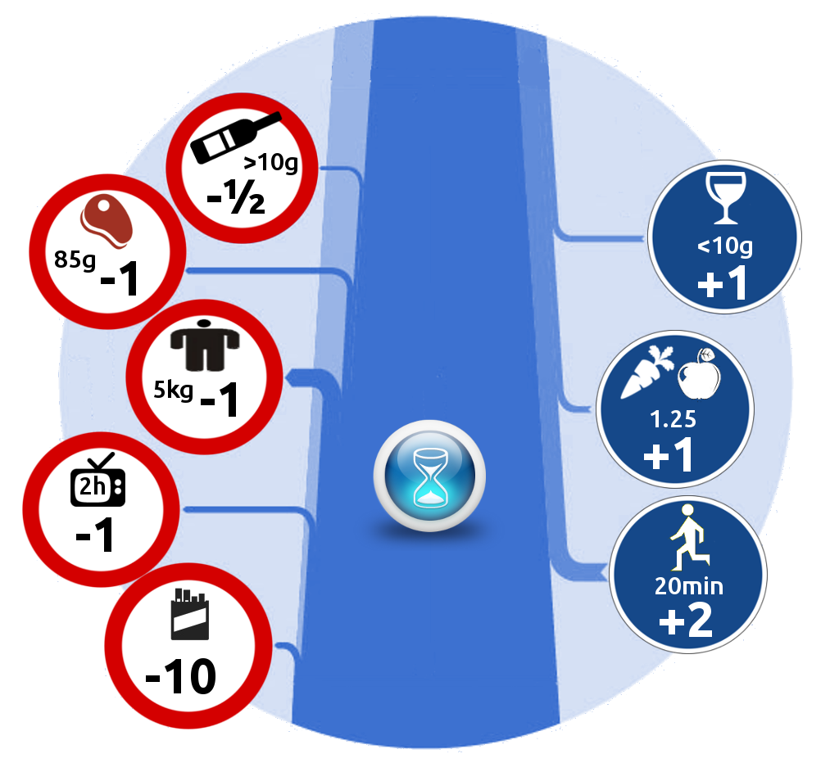
A “microlife”: a unit of risk representing 1/2 hour change of life expectancy
Notes:
“Introduced by David Spiegelhalter and Alejandro Leiva, microlives are intended as a simple way of communicating the impact of a lifestyle or environmental risk factor, based on the associated daily proportional effect on expected length of life. Similar to the micromort (one in a million probability of death) the microlife is intended for "rough but fair comparisons between the sizes of chronic risks".^{[1]} This is to avoid the biasing effects of describing risks in relative hazard ratios, converting them into somewhat tangible units. Similarly they bring long-term future risks into the here-and-now as a gain or loss of time.” (https://en.wikipedia.org/wiki/Microlife)

Slide 30
Nudge & “libertarian paternalism”
Choice architecture in line with humans’ bounded rationality. Examples:
default option (suscribed / unsuscribed) in voluntary pension plans causes huge differences in enrollment and savings
healthier food placed at sight level increases the likelihood that we opt for it
Long-term, would not people become worse decision-makers?

Slide 31
Managing communications Email example:
“I am ... from your class of Economic Organizations and Markets (group 2), I write you in order to comment some aspects of The Economist's article "Homo administrans". In the article, despite the fact that the author states that nurture and nature explain the differences between individuals and that both are important in order to determine our character, he just focus on showing experiments that seems to defend that biology is the only determinant of our character, almost without influence of our environment.
For me this is contradictory not just with his initial affirmation but also with other studies that suggest the importance of nurture to define our personality traits. For example, a couple of days ago I read an article which says, briefly, that environment helps to determine our character and that the role of genes seems to be help to determine the paths that people take in their environment (if you want to read it carefully here is the link: http://voices.yahoo.com/the-role-nature-nurture-shaping-human-behavior-2255780.html)”.

Slide 32
The same email, after being “pruned”
“I am ... from EOM class. I write to comment on the ‘Homo administrans’ article. Despite it states that both nurture and nature are important in explaining human behavior, it just focus on experiments that seem to defend that biology is the only determinant, almost without any environmental influence. You may see http://ow.ly/sUlkE”.

Slide 33
Multiple applications for other topics
What is the role of “emotions” in understanding and regulating markets, politics, institutions, and business firms?

